Slide 1
Etwinning project 'What tool is it?'
Serbia - Slovakia
(Erasmus+ project- 'This is how we share' )
Mini eTwinning project
Partners : Serbia - Slovakia

Slide 2
About the project
This project is a subproject of an existing project "This is how we share" which is an Erasmus+ Project as well. Project is focused on using various ICT tools in learning and teaching processes in both partner schools - Slovak and Serbian one following the aims stated in Erasmus + project.
There were two actitivies and students’ interaction and collaboration in completing educative tasks related to using technology. Five teachers were involved in this mini project. Two teachers from Serbia, Vesna Jaquet and Nataša Mihailović and three theachers from Sovakia, Daniela Tomašovičova, Kristina Liparova and Dominika Prochazkova.
The aims were that the students were supposed to learn more about various ICT tools, exchange experiences, learn from each other, become more independent by recognizing and using most common ICT tools, make learning more interesting and effective, improve English through communicating, exchanging and using various applications.

Slide 3
Planned activities
Work process was organized in three tasks
1. Making a padlet - an ICT tool to introduce kids from both schools
2. Quiz - Who wants to be a millionaire? - playing a game to find out the level and the number of ICT tools they are currently using
3. Writing practice - ’This is my tool’- every school will introduce chosen ICT tool, do an education activity, show it to the partner and then they will swap the roles to be able to use this tool. Students were practicing using Word. They were rewritting a text correcting the mistakes, writing capital letters and marks of interpuntion where needed. Then,they saved the text on their computer in documets file and prepared it for sending it as their assignment in the google classroom.
The activity was conducted with 3rd graders and it was useful. They learned how to use the Word and follow most common instructions for writing a school text.
4. Grammar practice online activity - Students of both teams will plan a grammar class for revising knowledge using an iTool.

Slide 4
Project results
Expected results were making the List of favourite ICT tools, Padlet - our eTwinning international class, photos about using ICT tools in education processes in both schools. Students were developing digital competencies and learning the basic usage of most common ICT tools.

Slide 5
Activity 1- Introducing teams
Padlet – teams introduction - https://padlet.com/domiprochazkova93/m7yapf87hbr5v4t2

Slide 6
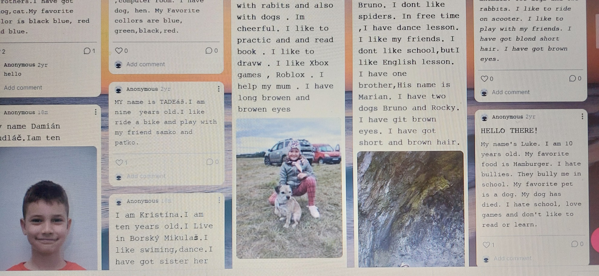
Padlet – introduction class

Slide 7
Activity 2
Quiz Quiz - Who wants to be a millionaire? - creating a quiz and playing it to find out the level and the number of ICT tools students are currently using,recognizing most common ICT tool and what they are used for
Quiz - https://take.quiz-maker.com/QP7UAQUEW
Quiz- https://learningapps.org/display?v=p4fzrbgit21

Slide 8
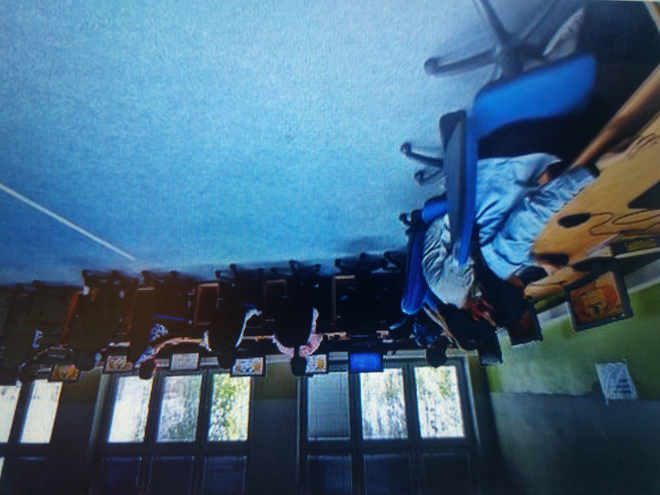
Slovak quiz for Serbian team!

Slide 9
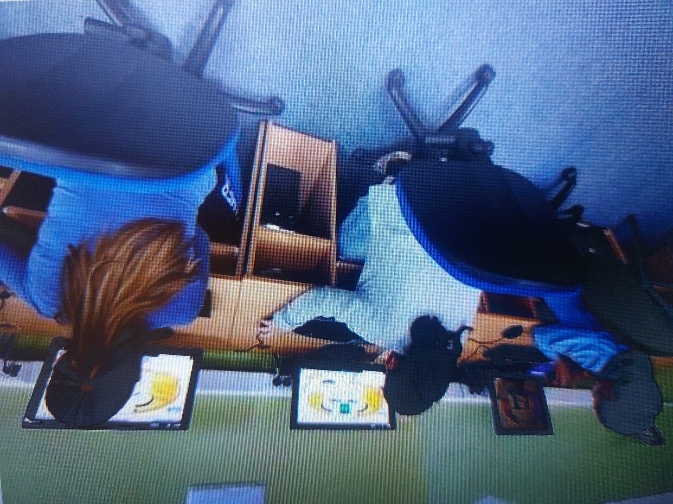
Slovak quiz for Serbian team

Slide 10
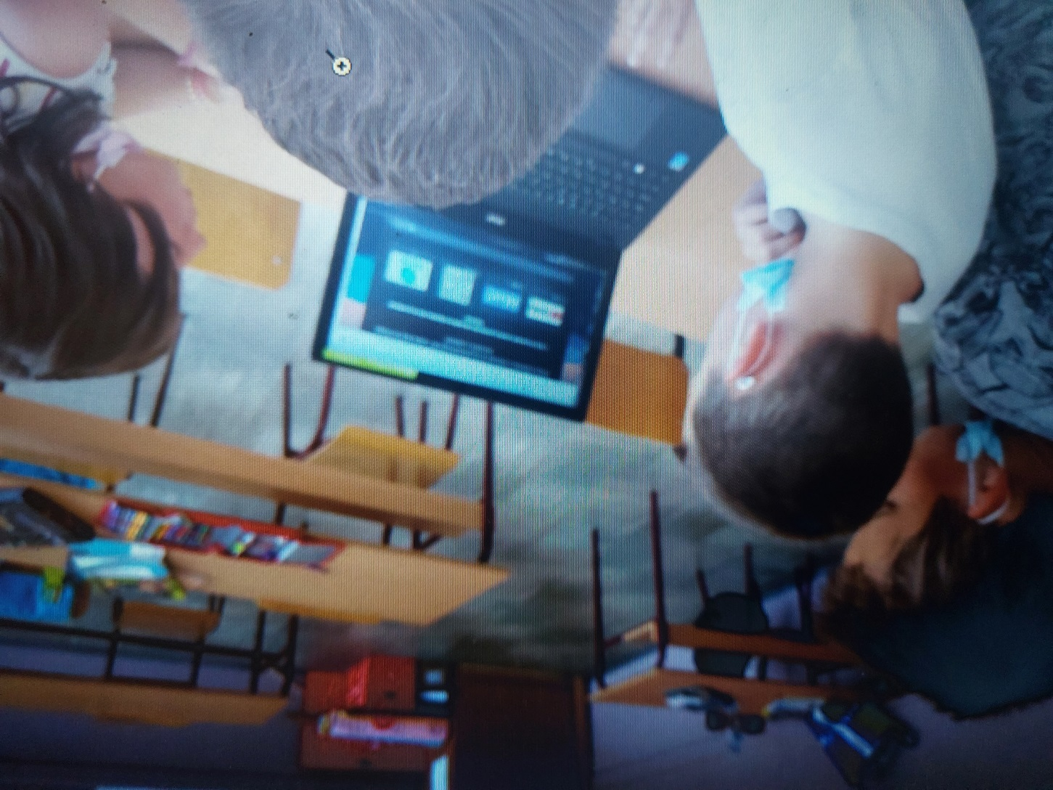
Serbian quiz for Slovak students

Slide 11
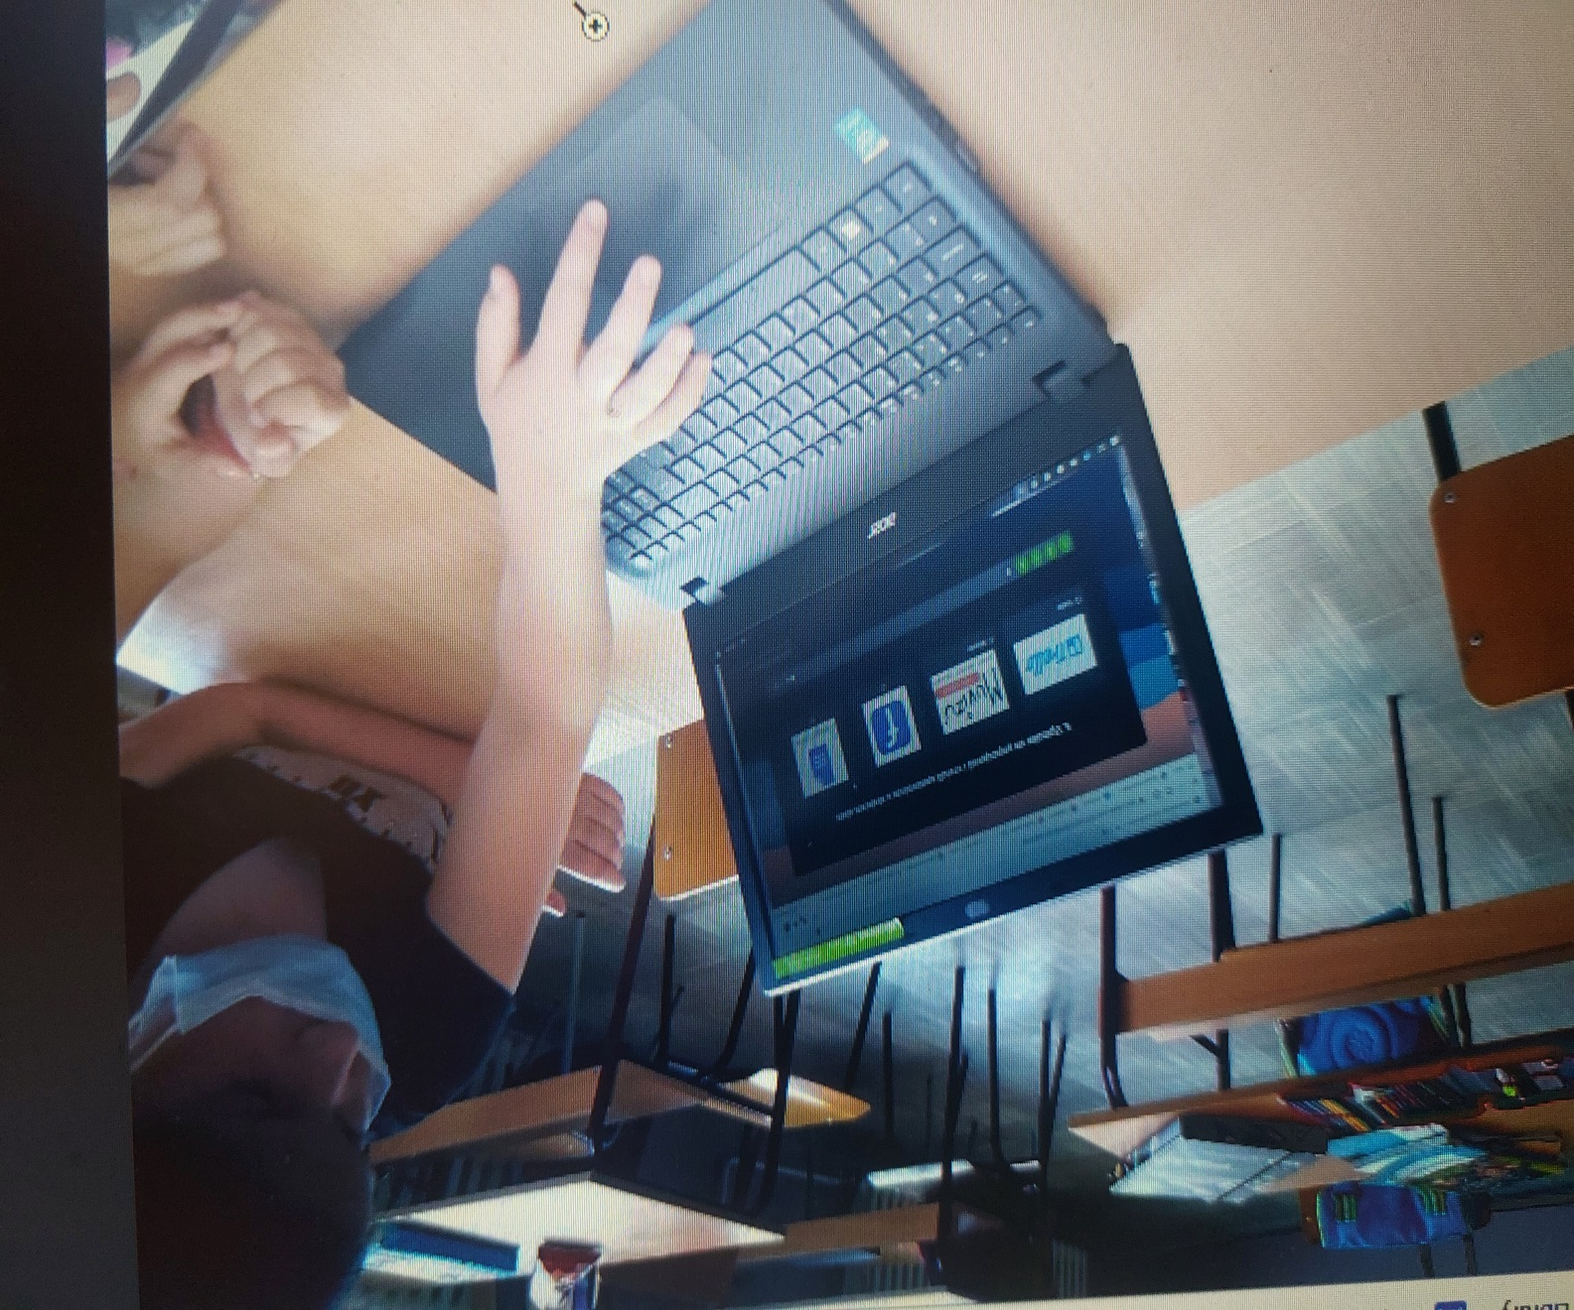

Slide 12
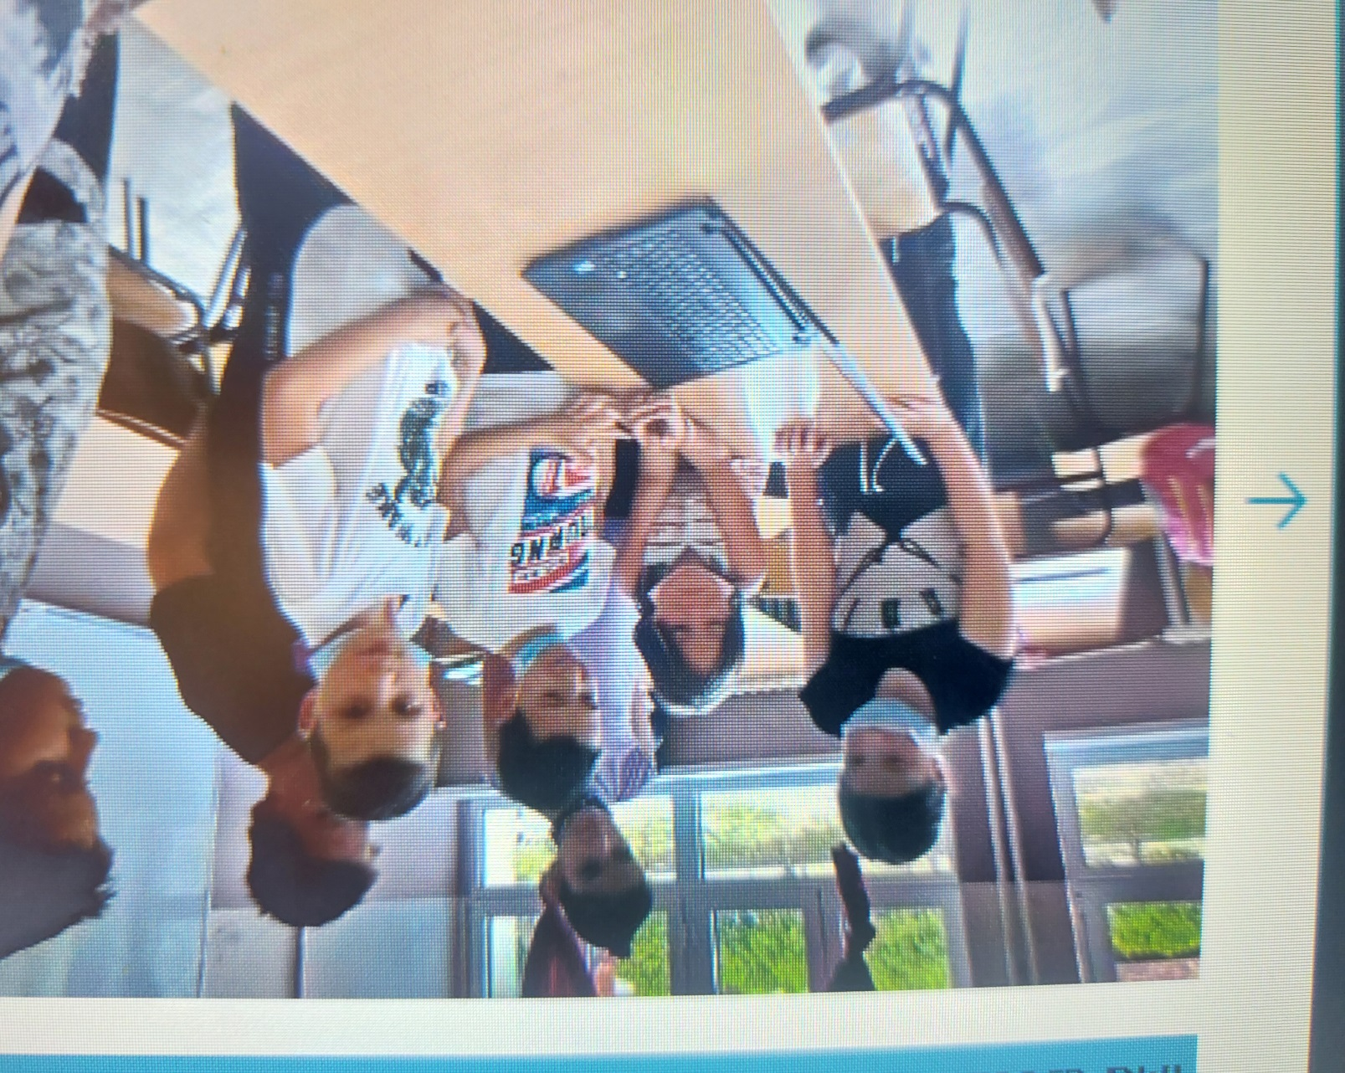

Slide 13
Activity 3
Writing activity - This is my tool
The third activity was conducted with 3rd graders and it was very useful. They learned how to use the Word and follow most common instructions for writing a school text. Both teams used suggested tool for writing practice and exchanging experience.
Both Slovak and Serbian students were practicing using Word during ICT lessons. They rewrote a text correcting the mistakes, writing capital letters and marks of interpunction where needed. Then,they saved the text in their computer in documets file and prepared it for sending it as their assignment in the google classroom.

Slide 14
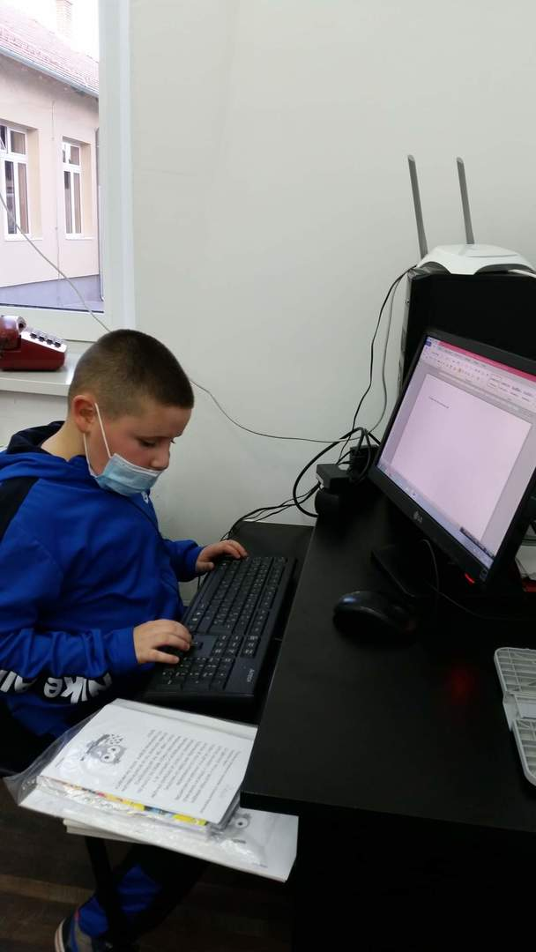
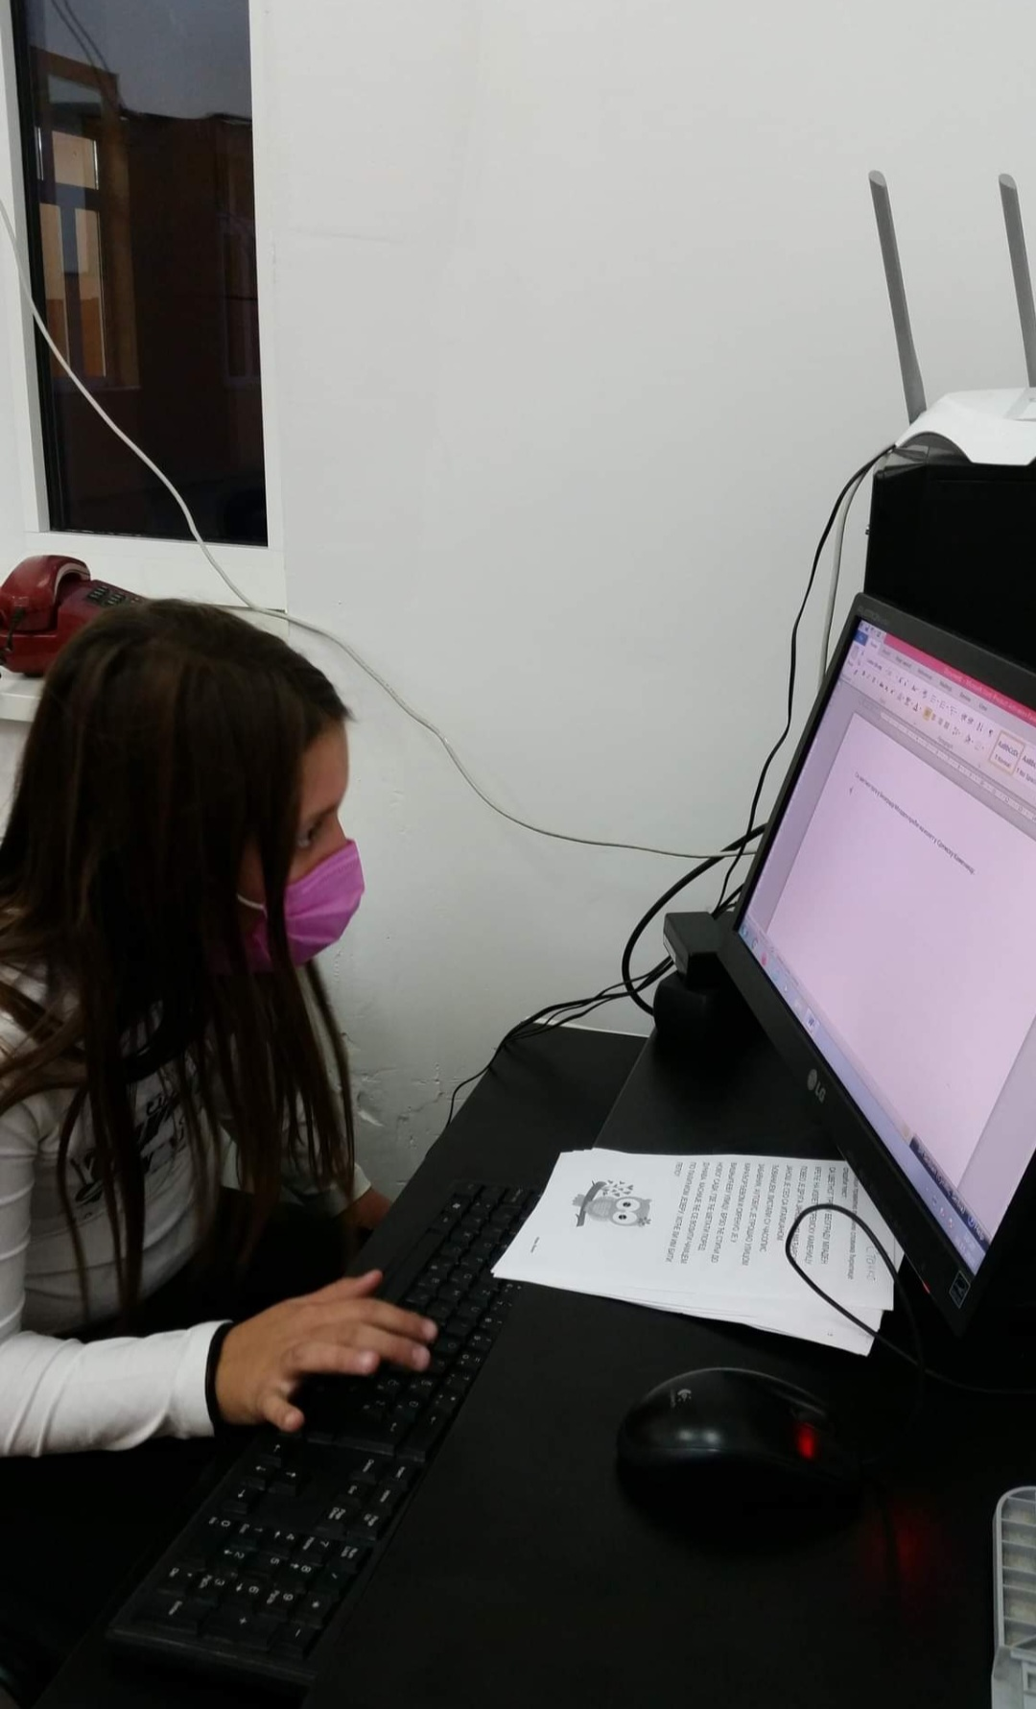
Activity 3

Slide 15
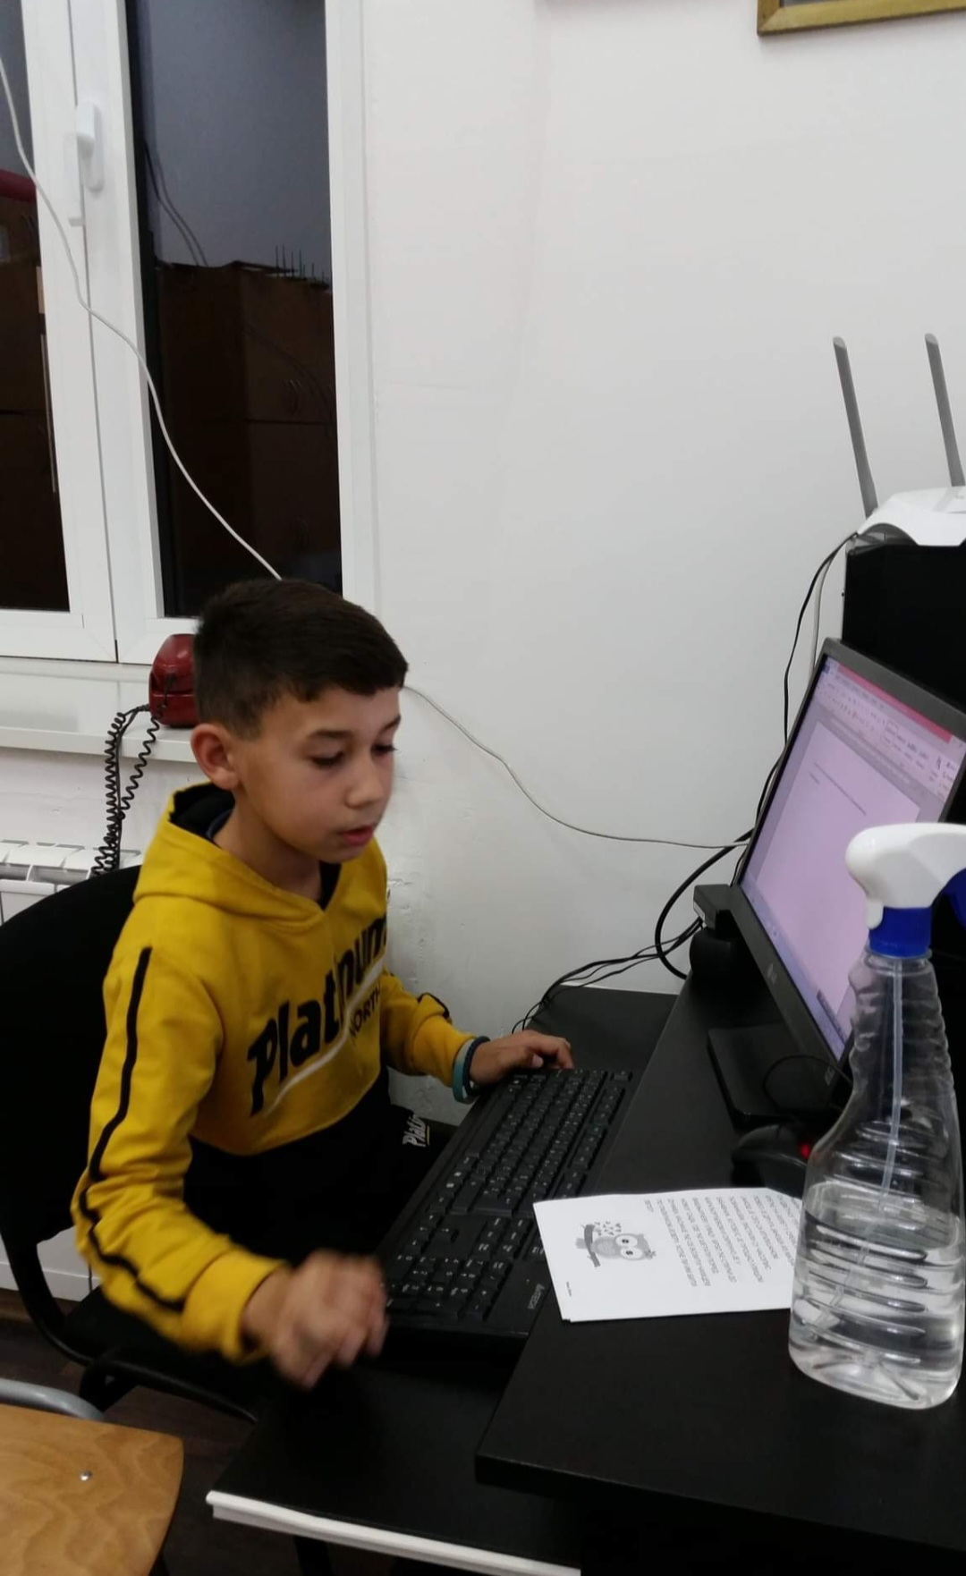
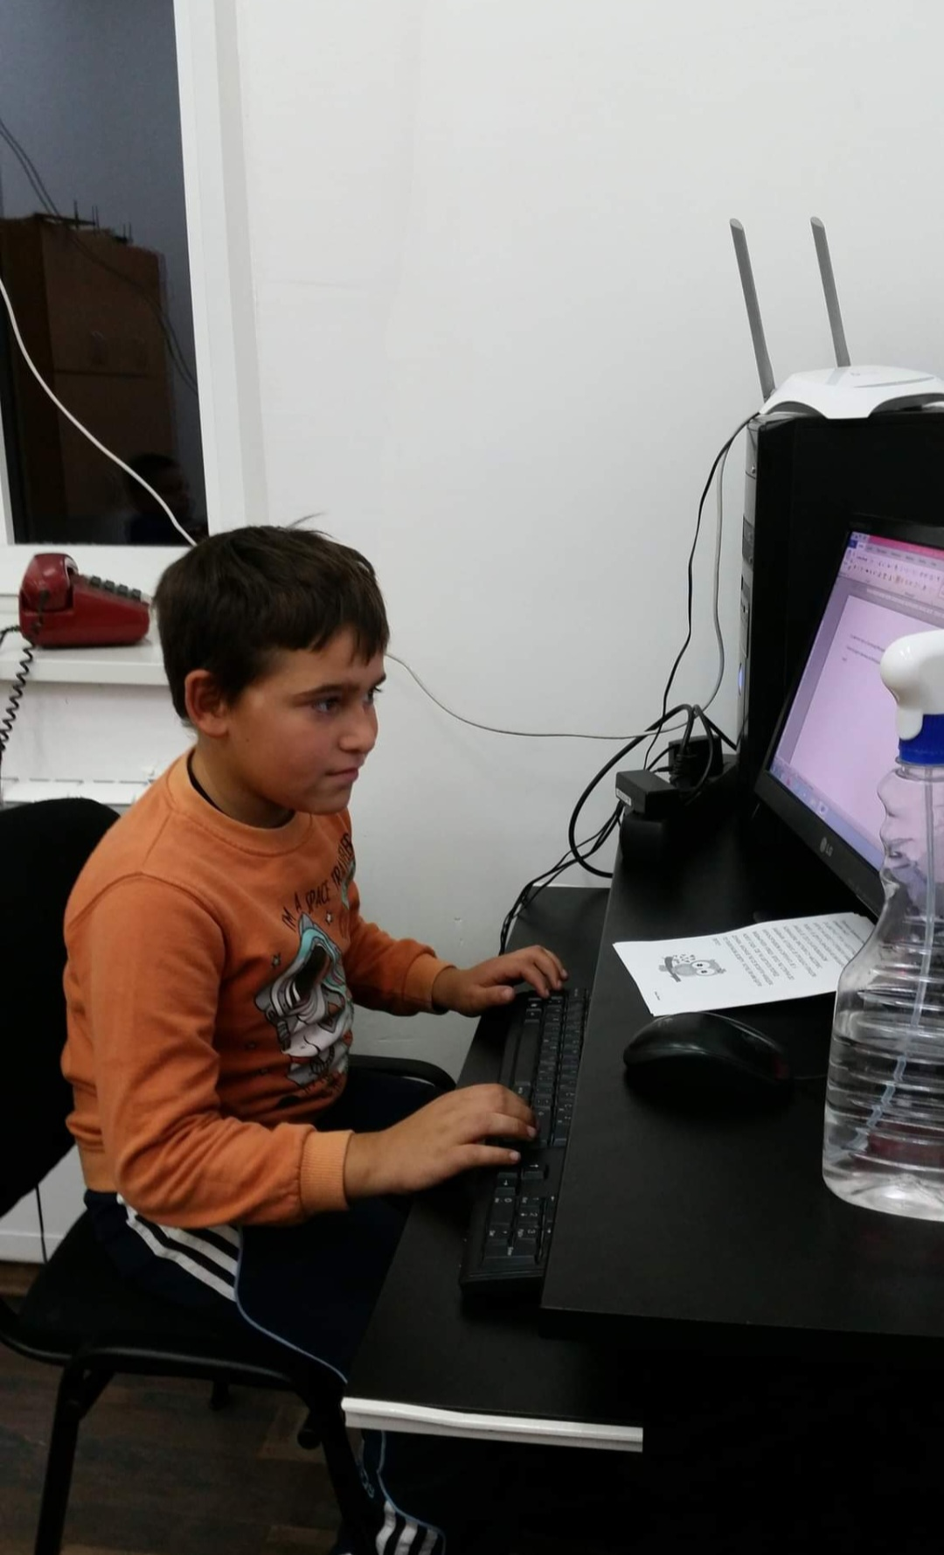
Writing practice - Word

Slide 16
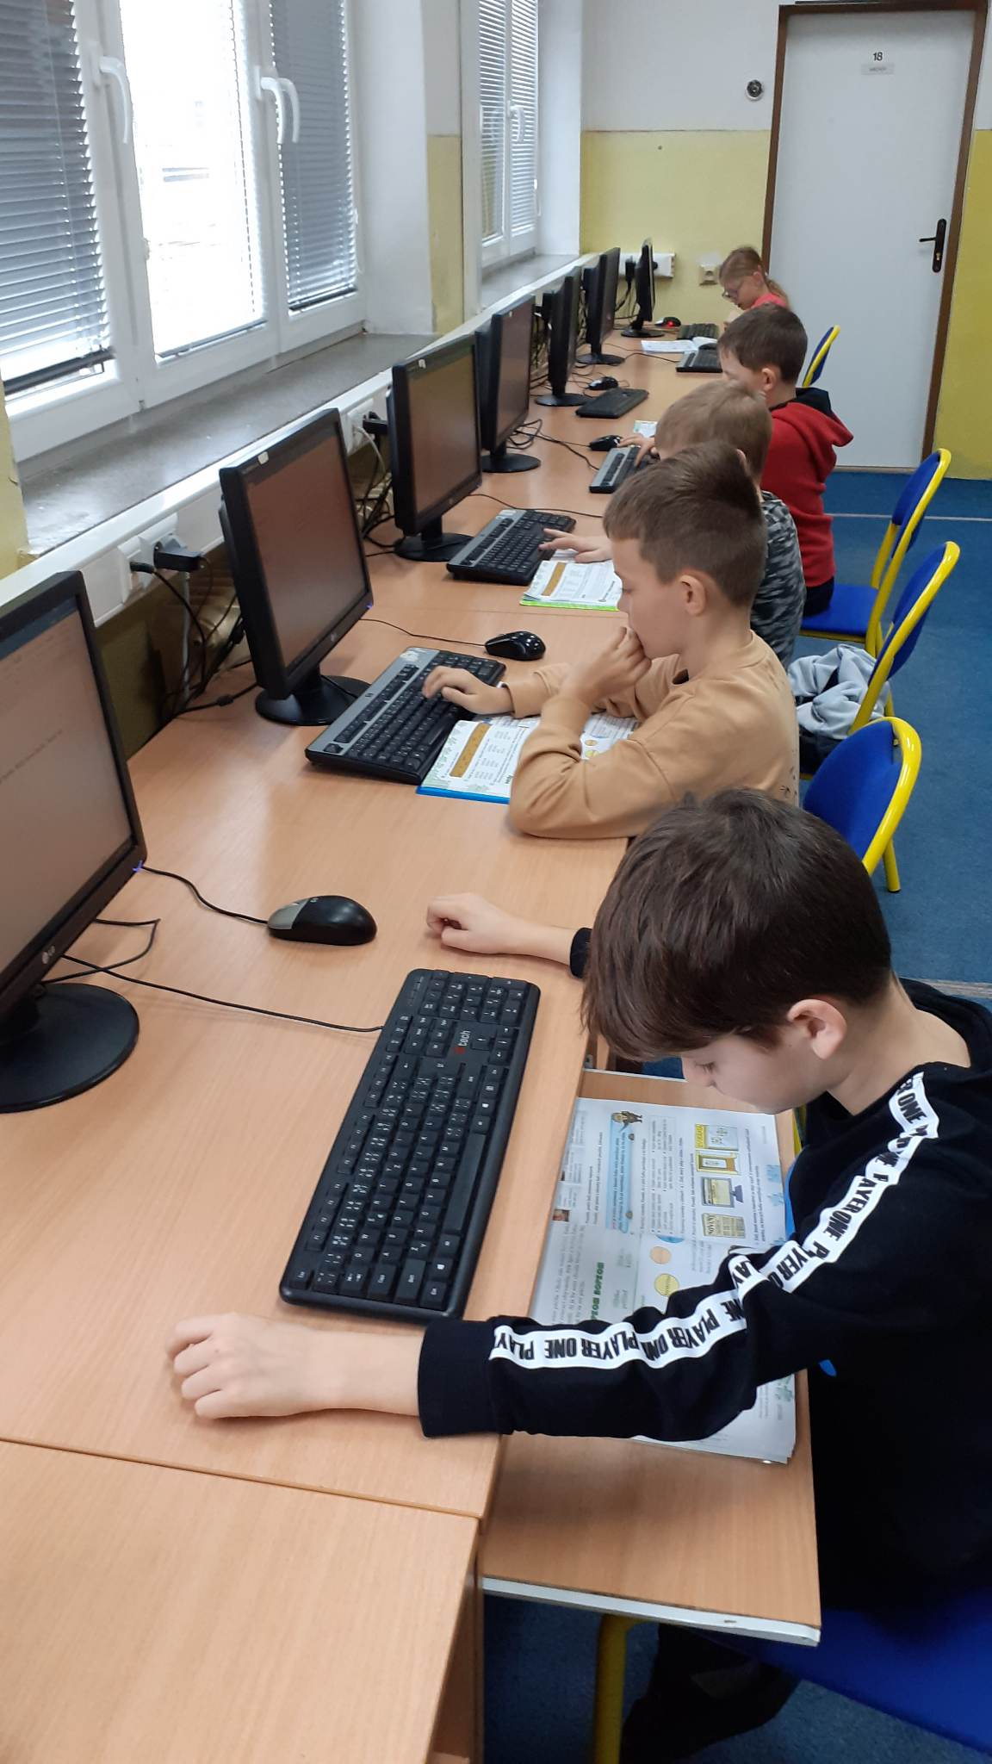
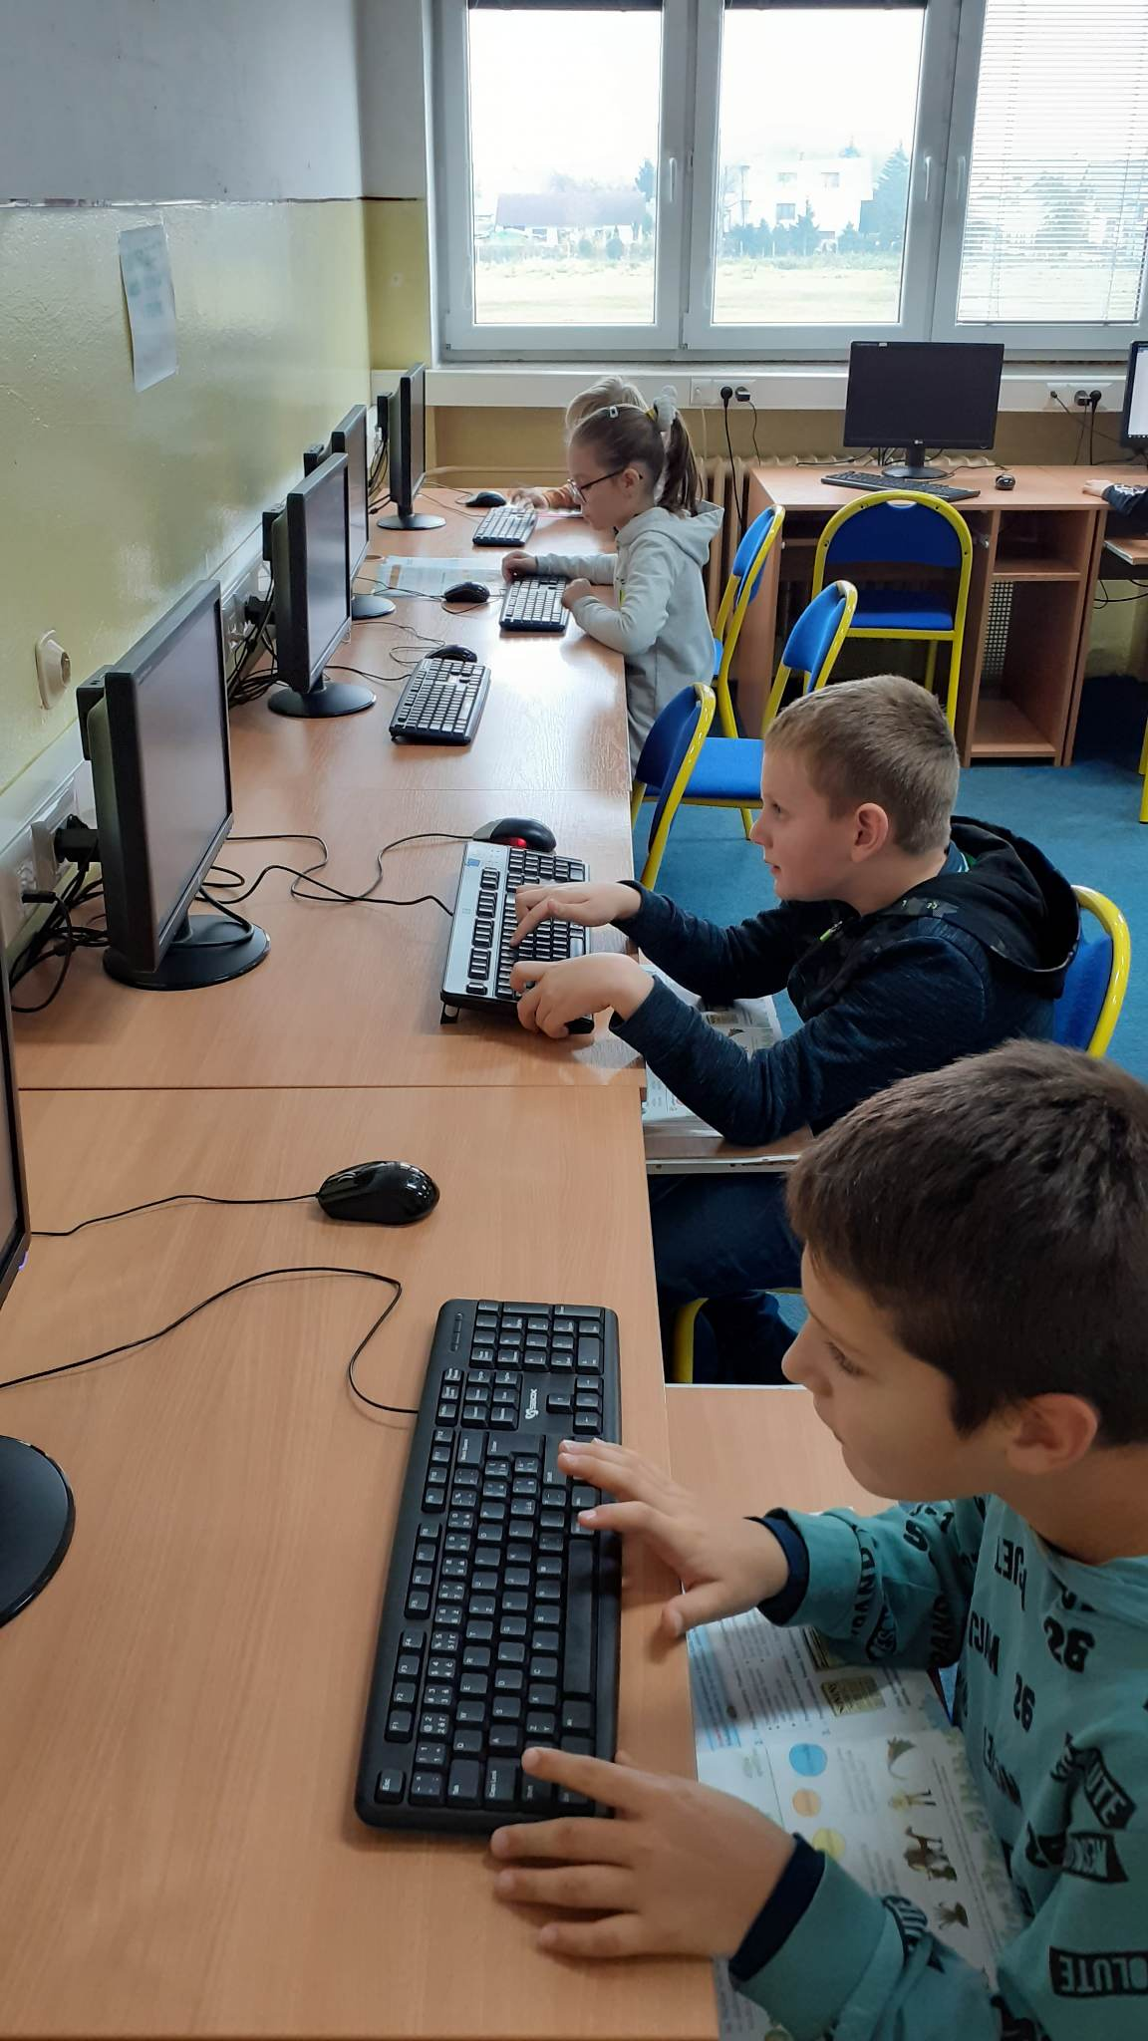
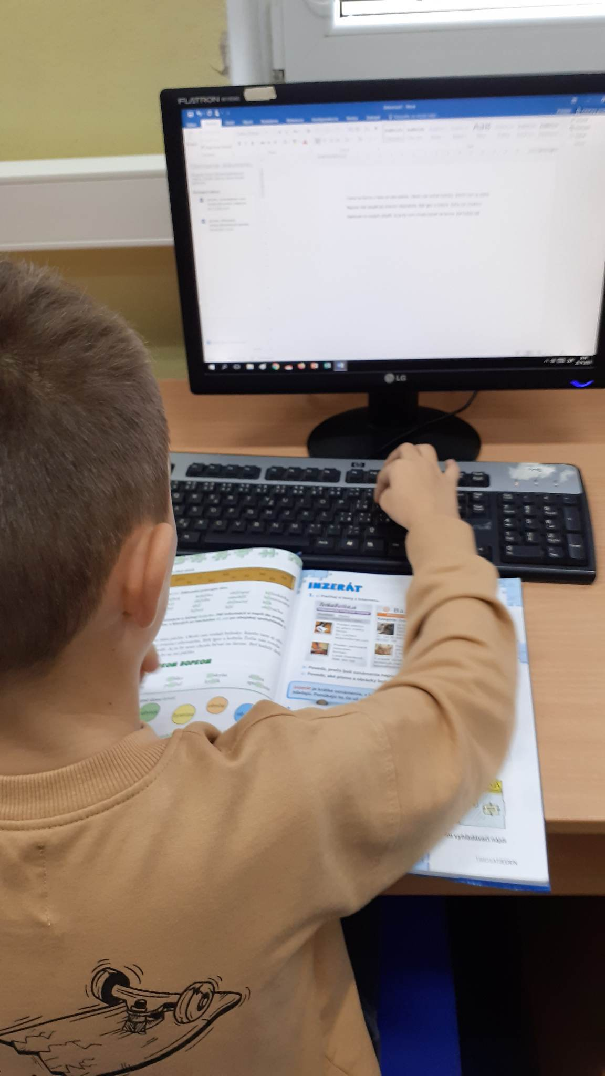

Slide 17
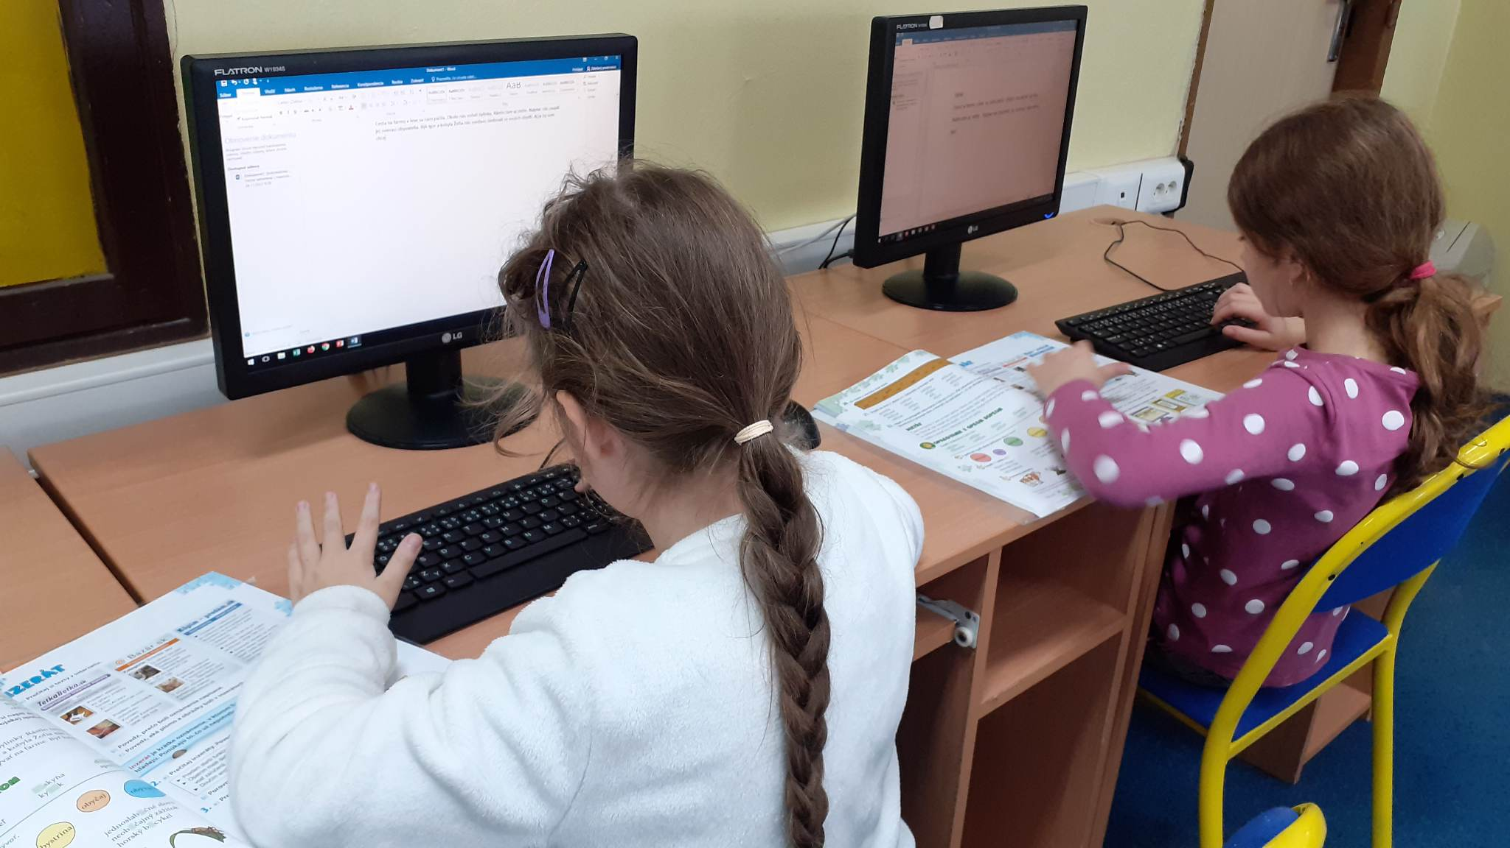
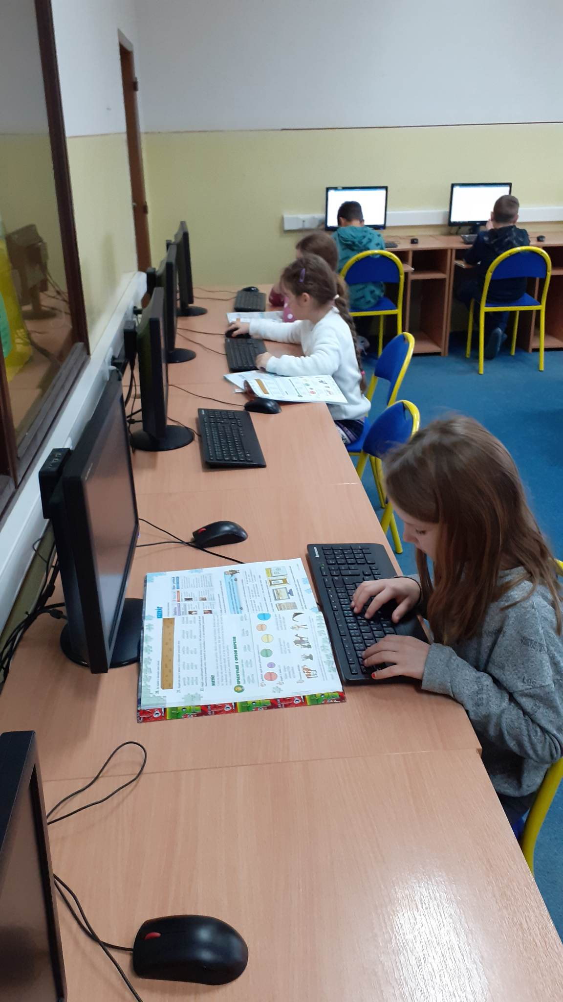

Slide 18
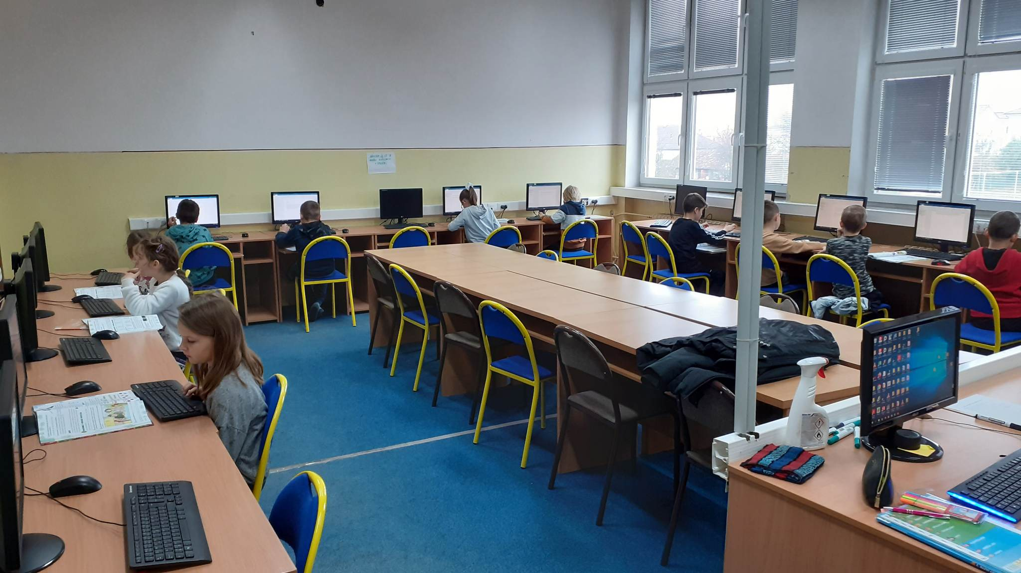

Slide 19
Activity 4
The fourth activity within this mini project was using iTools. Our 3rd graders use the textbook Family and Friends in their English lessons, so we used iTools for this book and practised lessons which were taught and studied to revise their knowledge. Kids love working with interactive whiteboard and their learning is more effective, interesting and fun.
Serbian team also practiced using iTools on the Interactive whiteboard for revising grammar rules. They loved this tipe of practice.

Slide 20
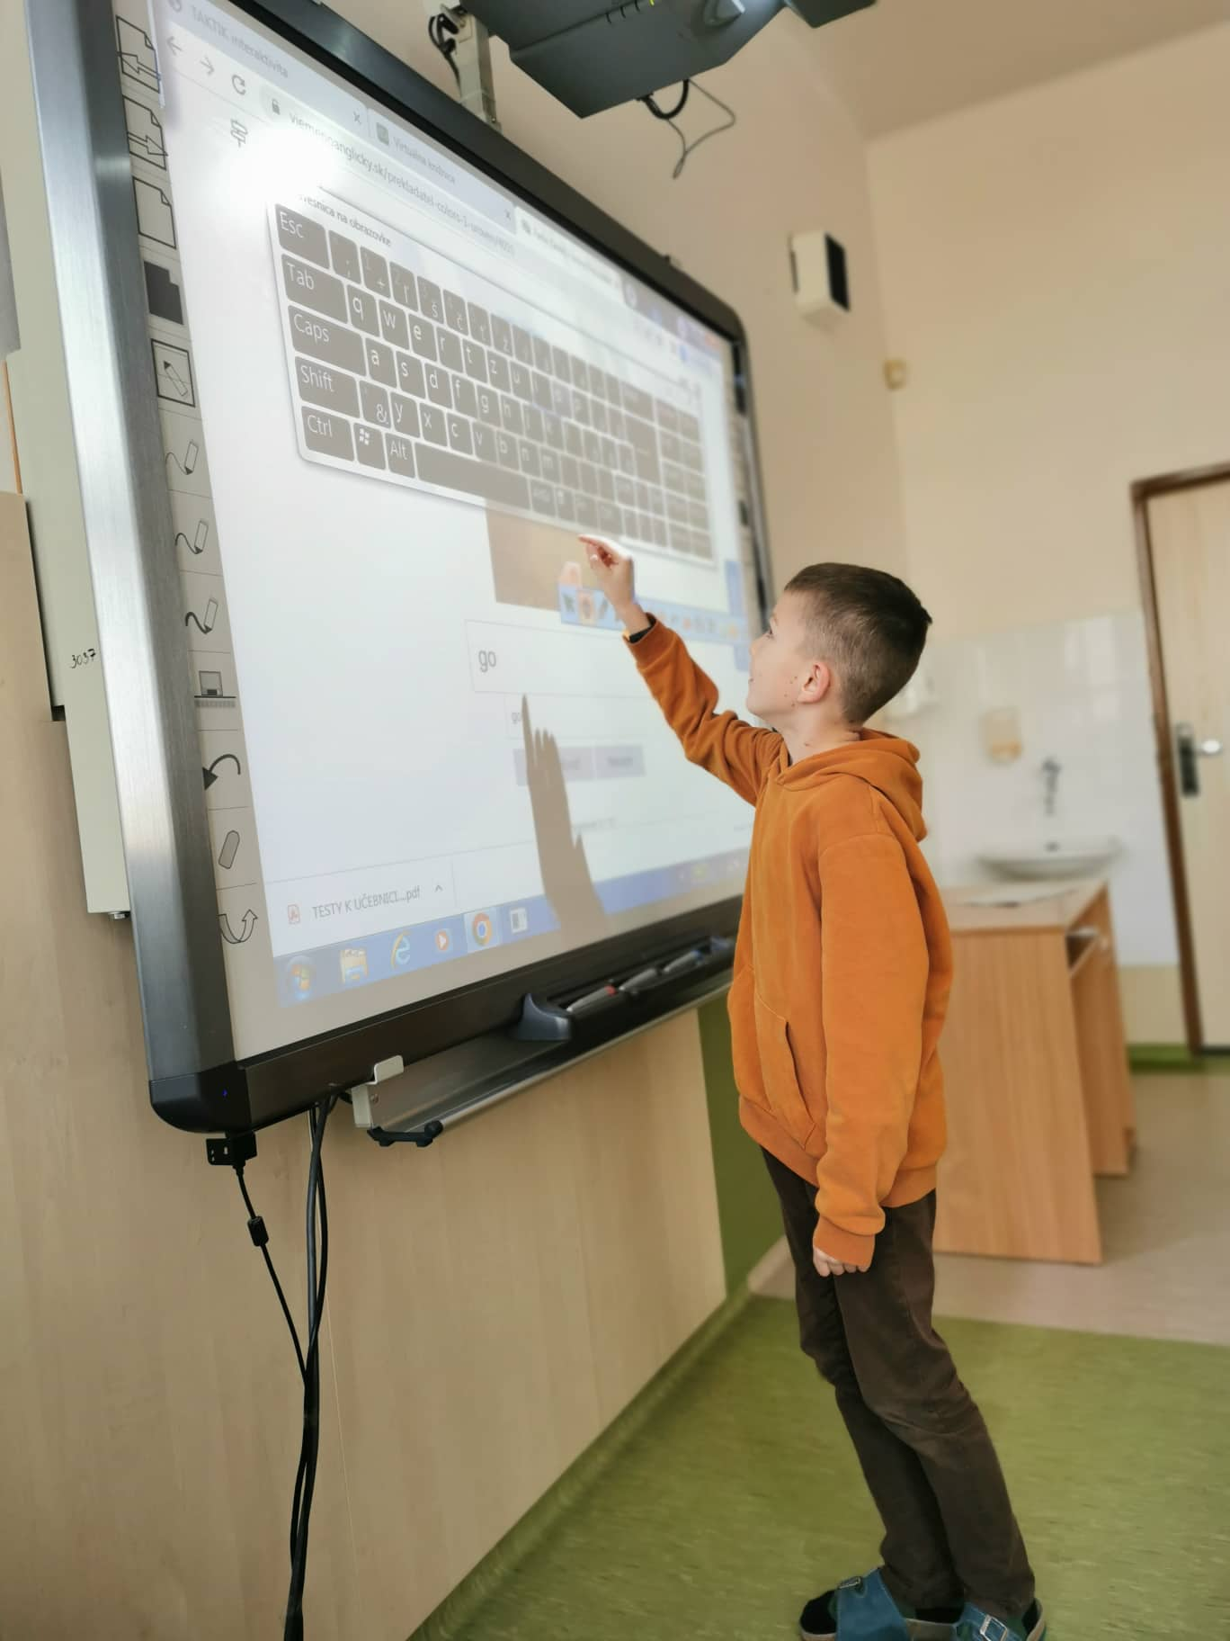
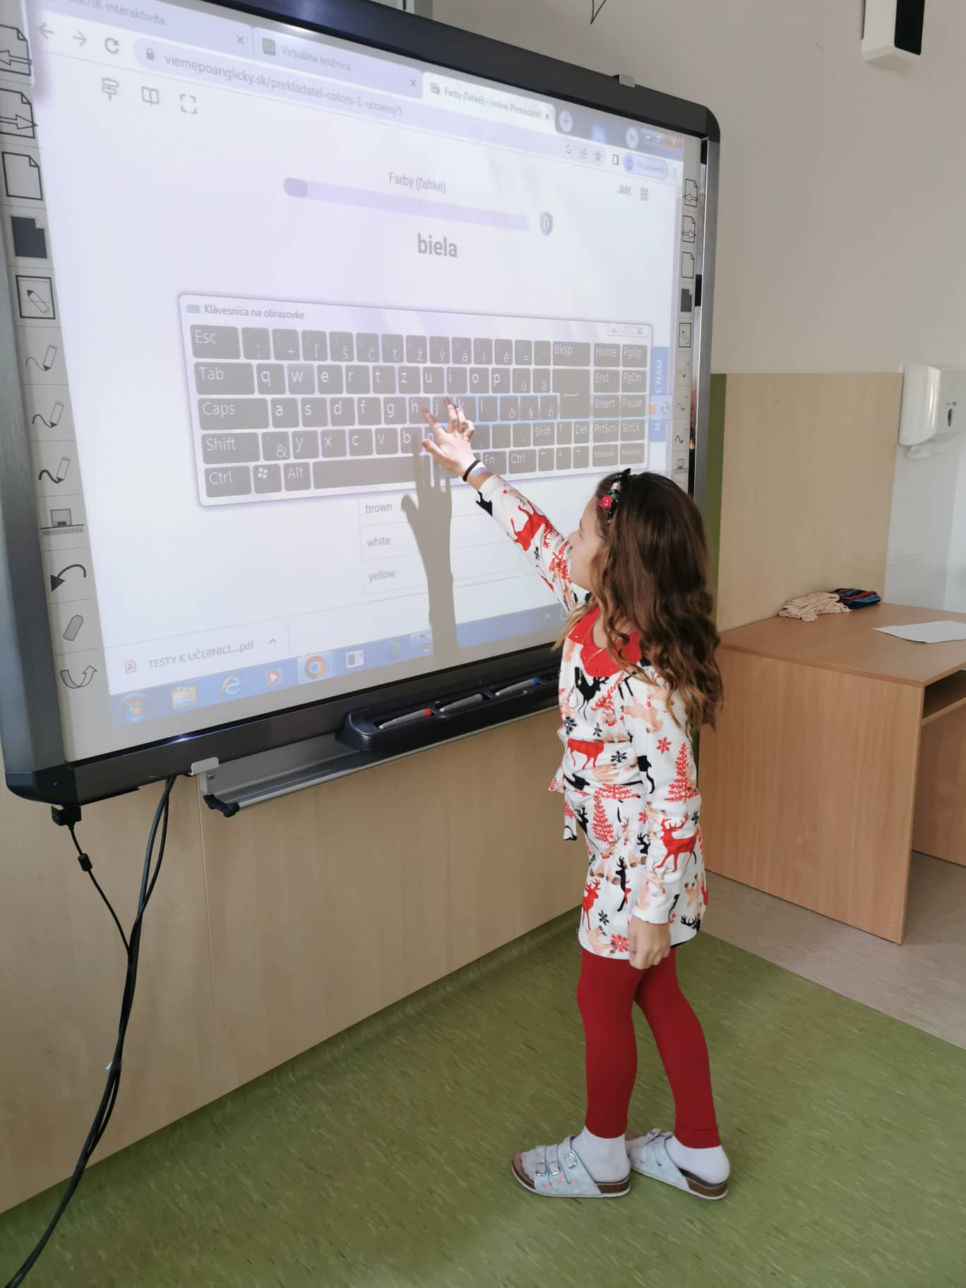

Slide 21
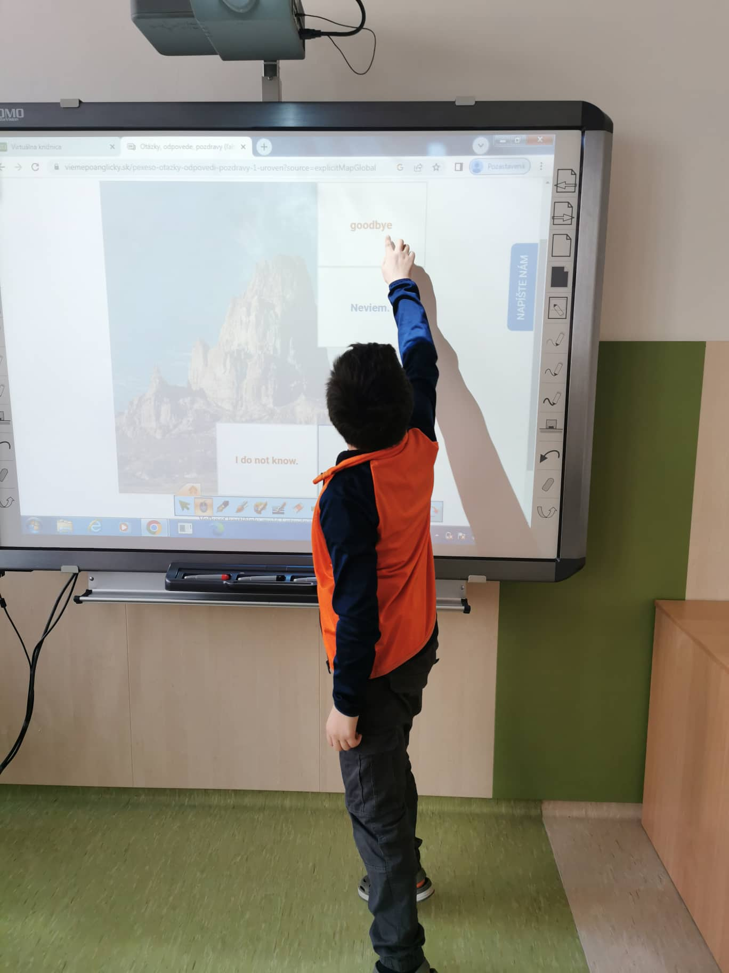
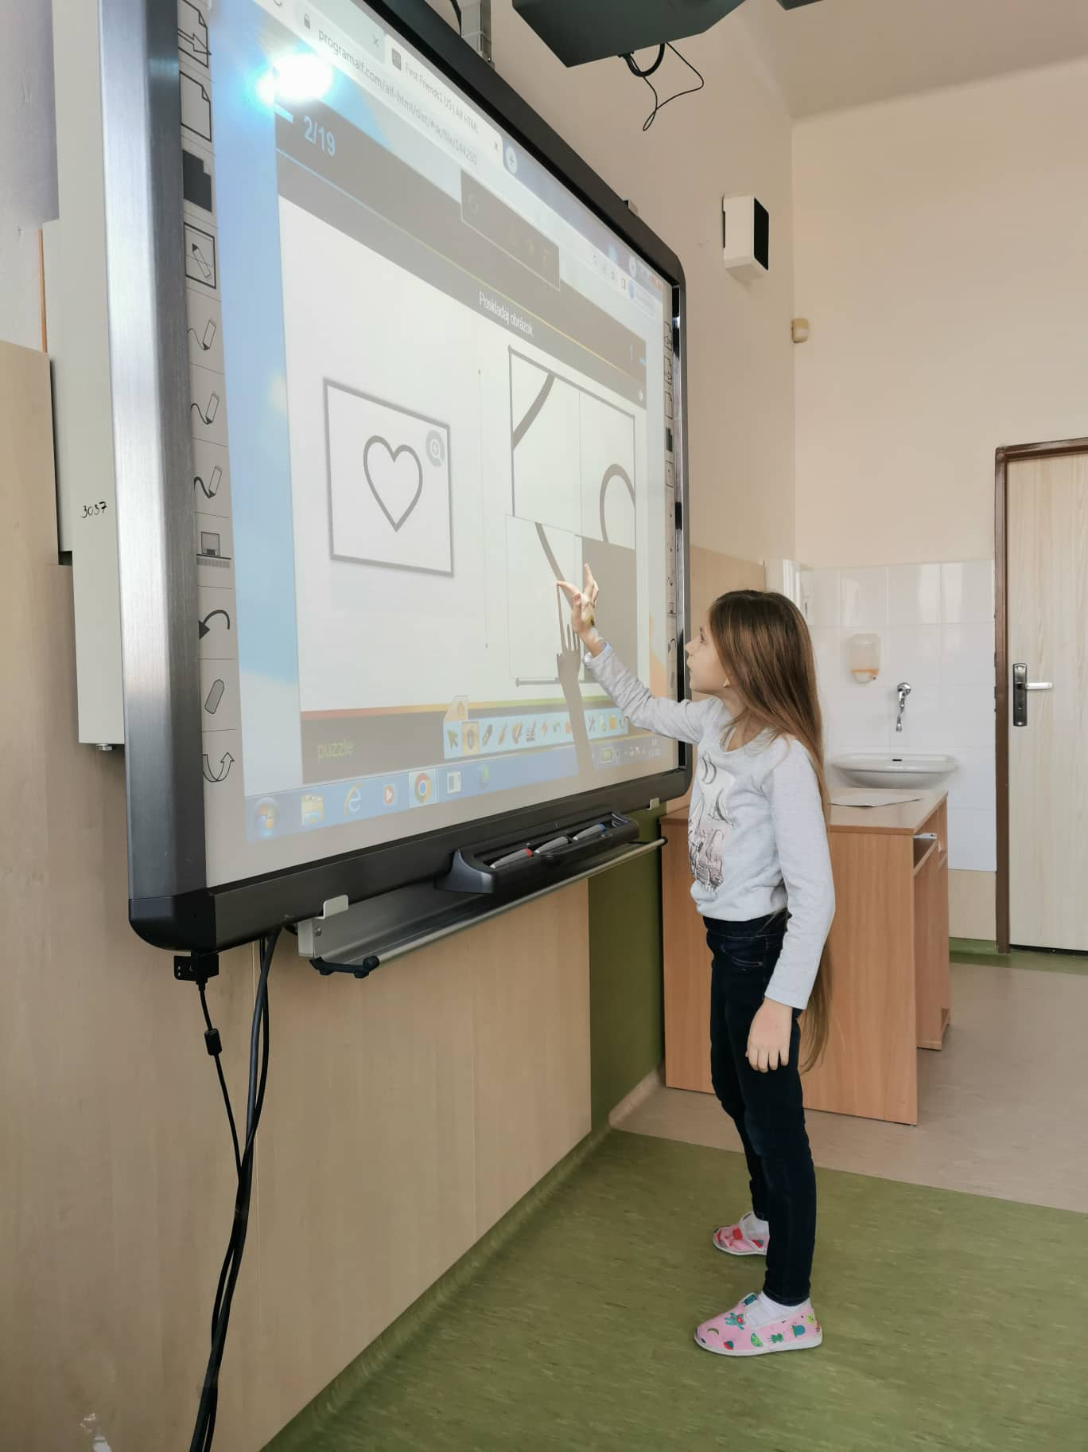

Slide 22
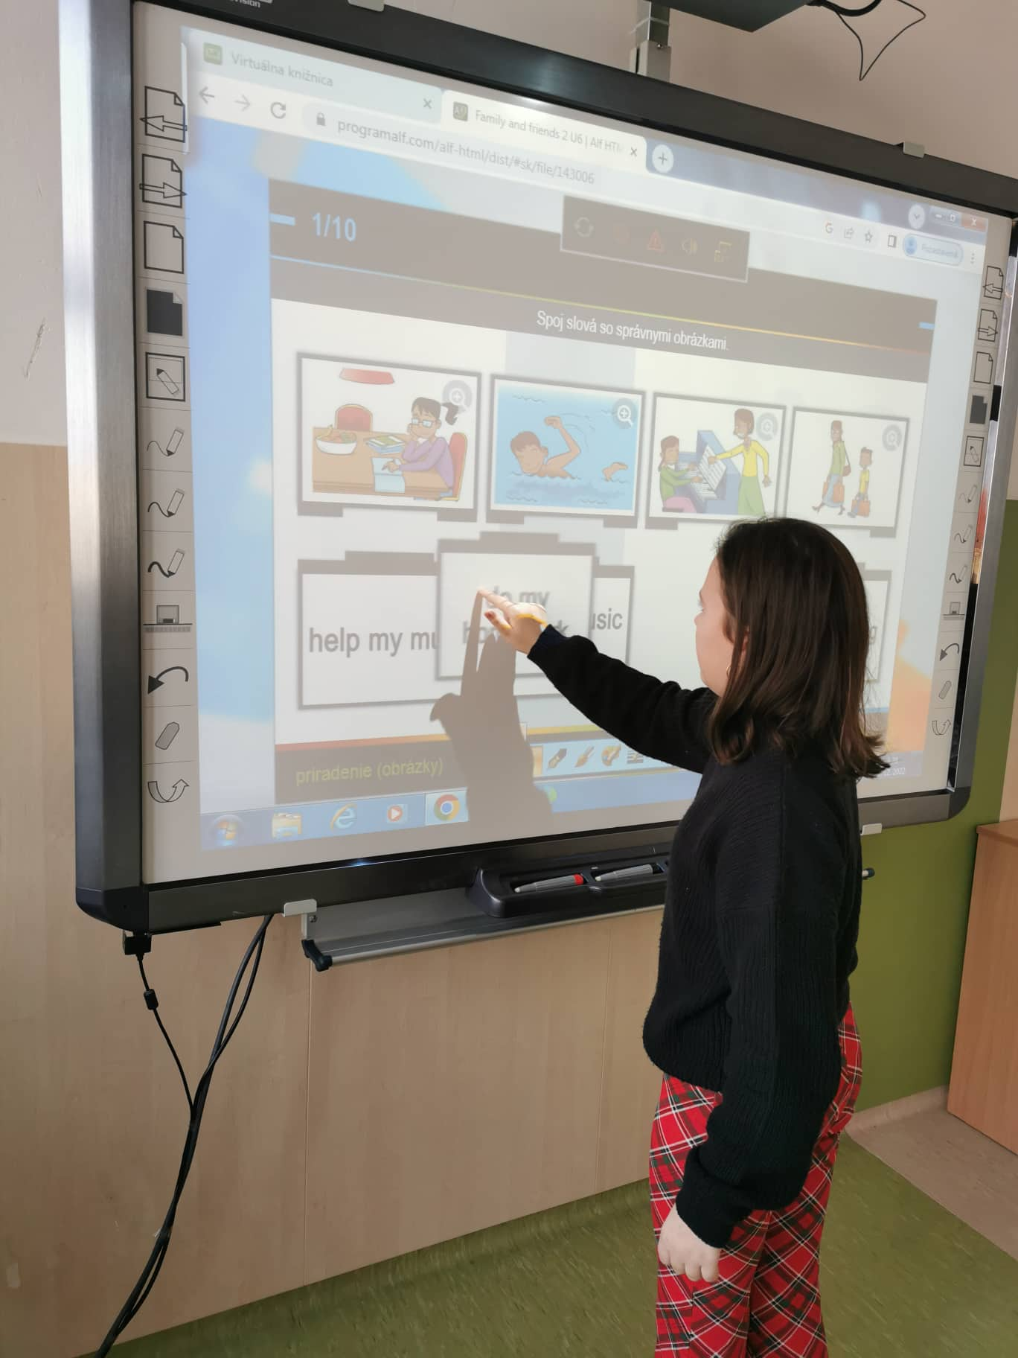
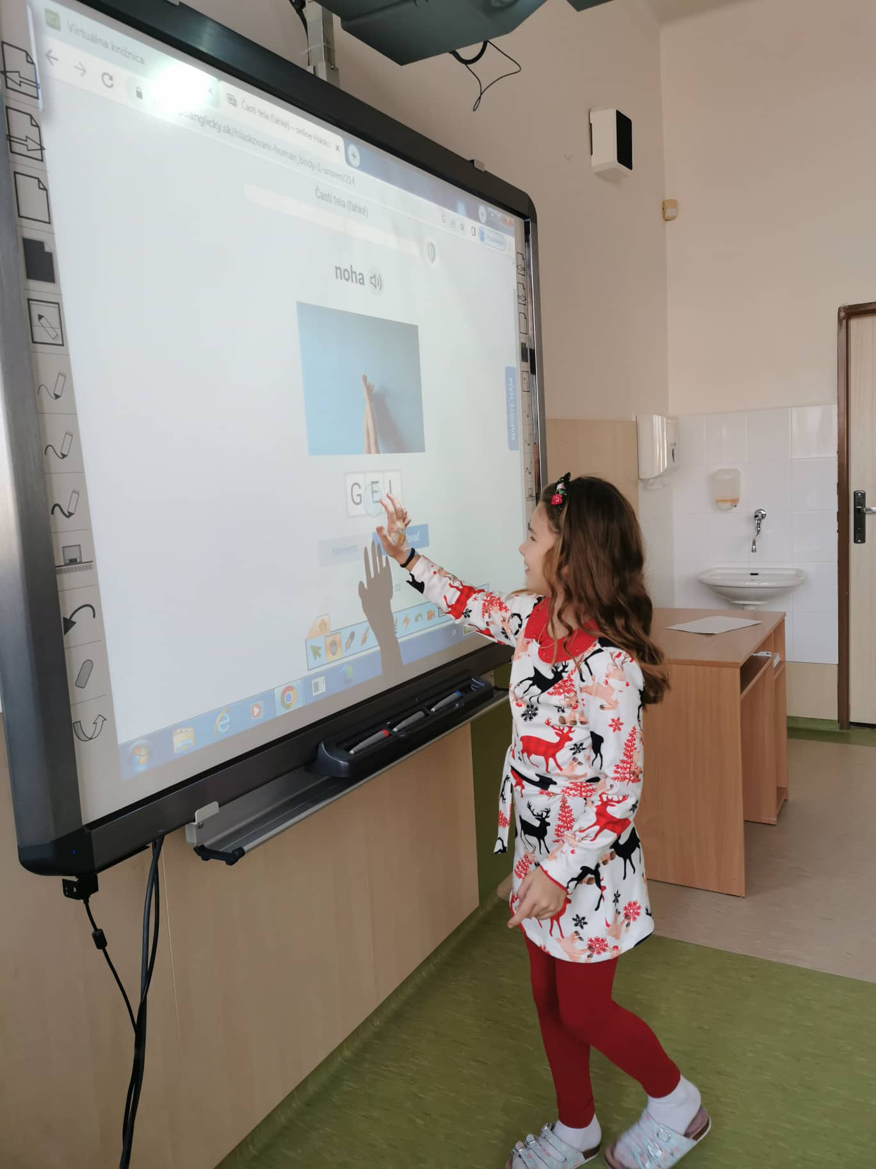

Slide 23
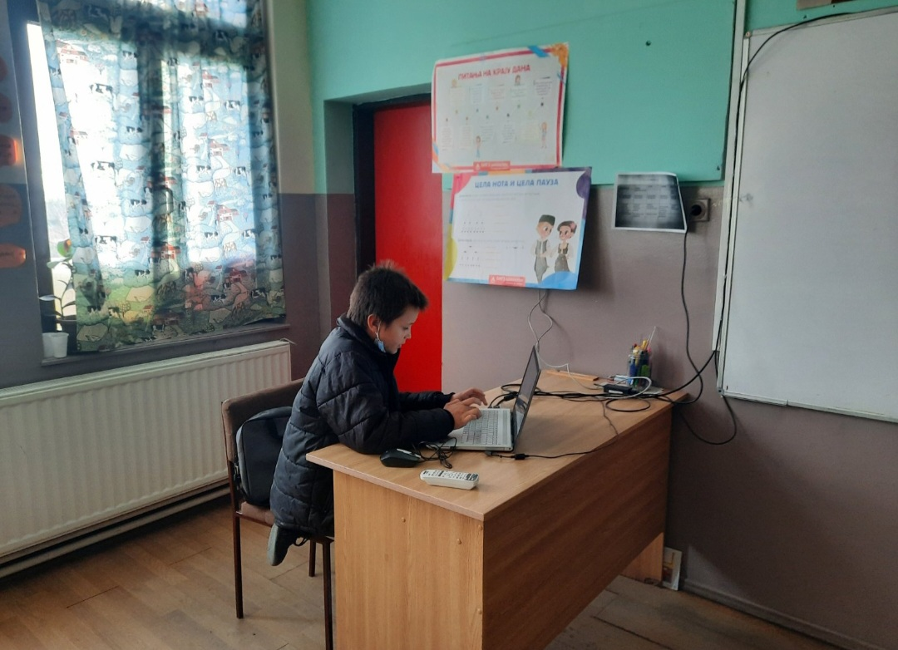
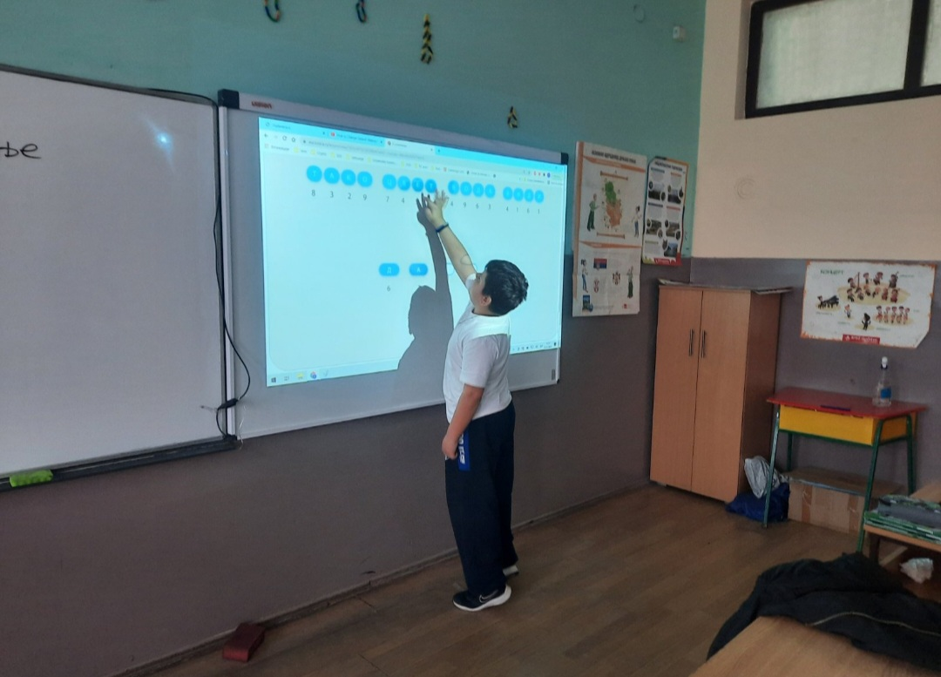
Activity 4

Slide 24
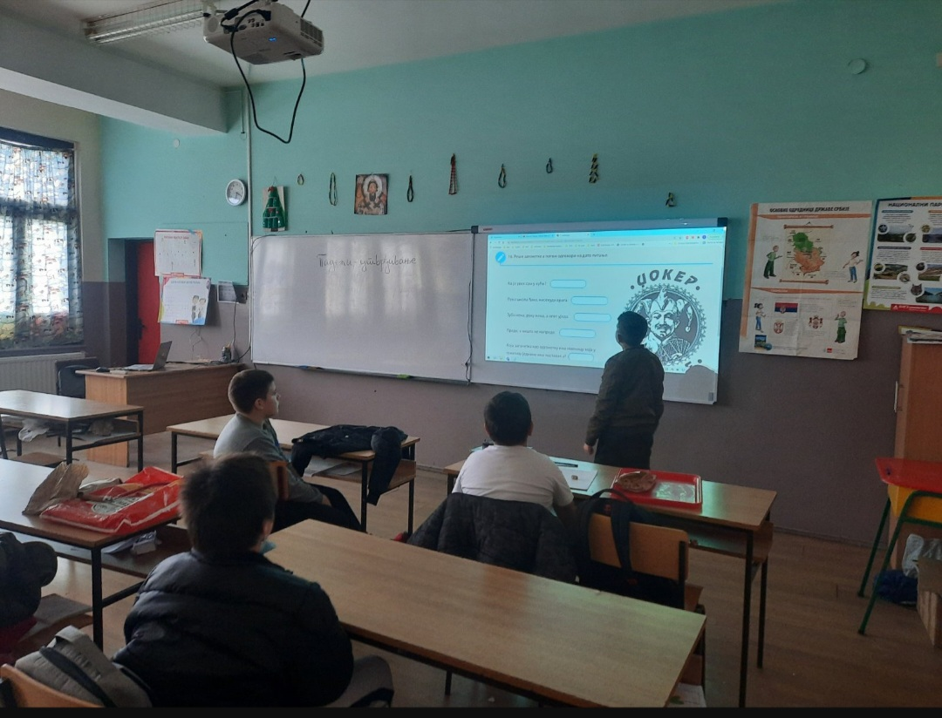
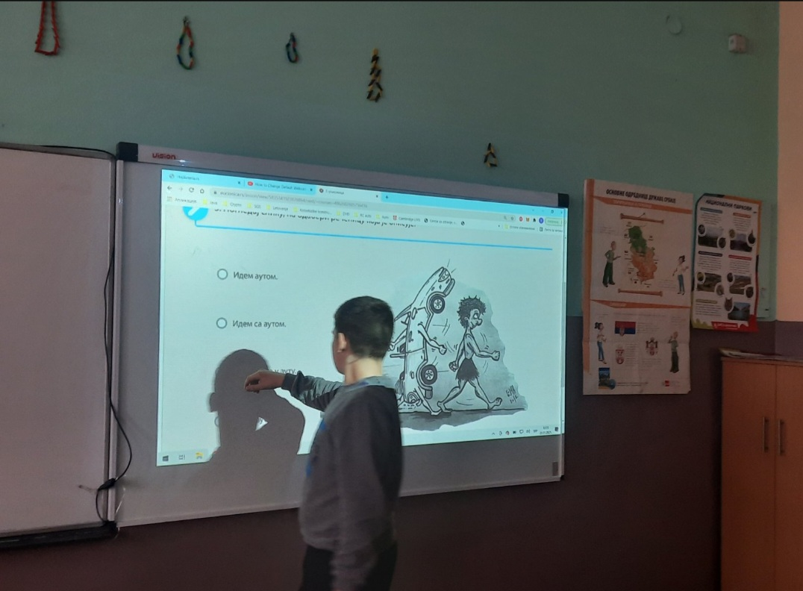

Slide 25
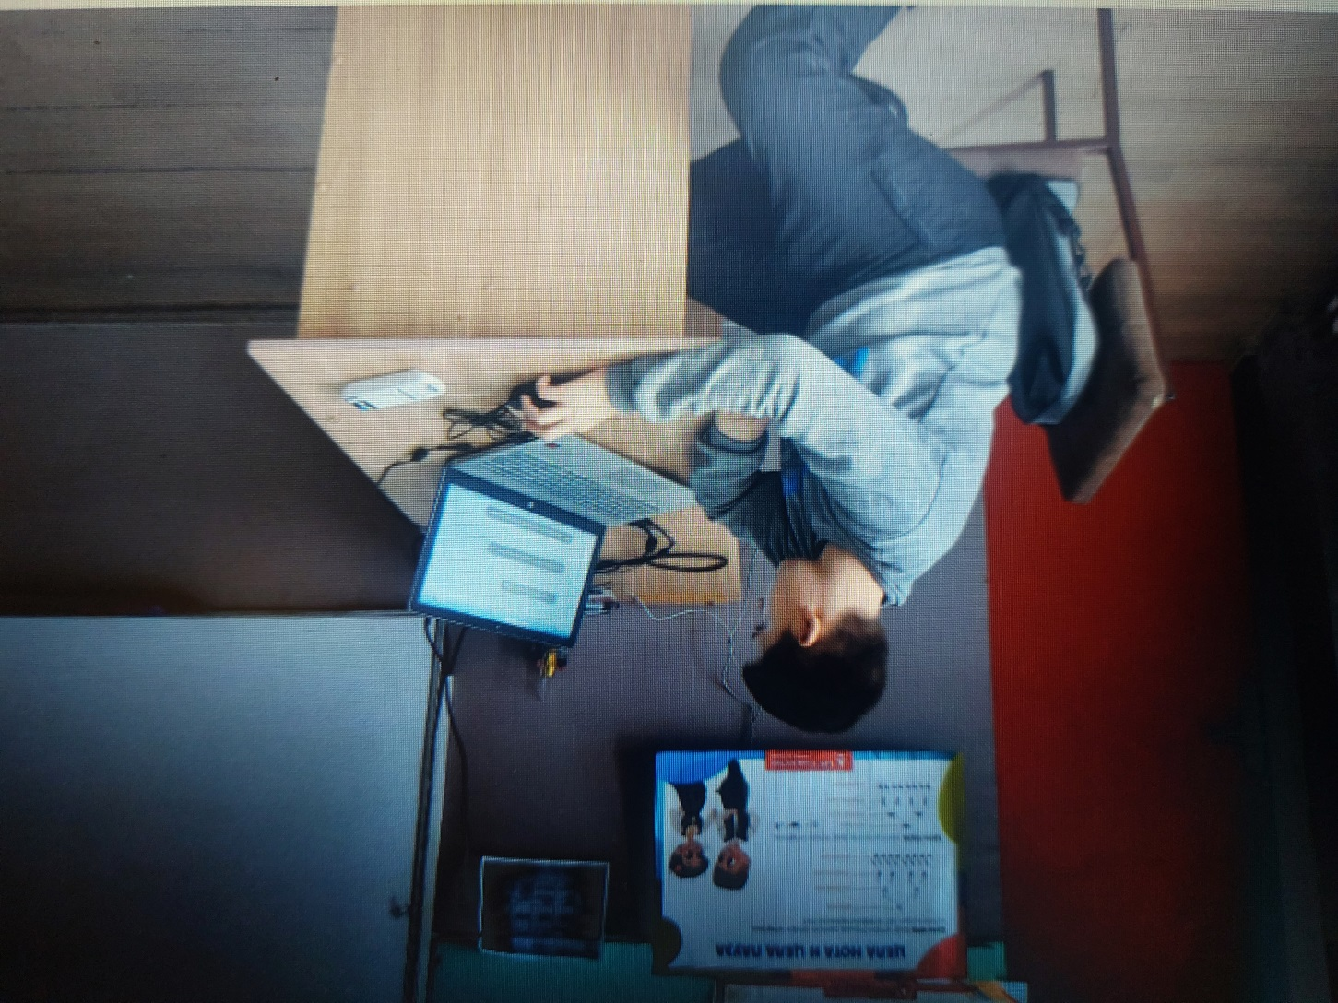
Students coordinating the class

Slide 26
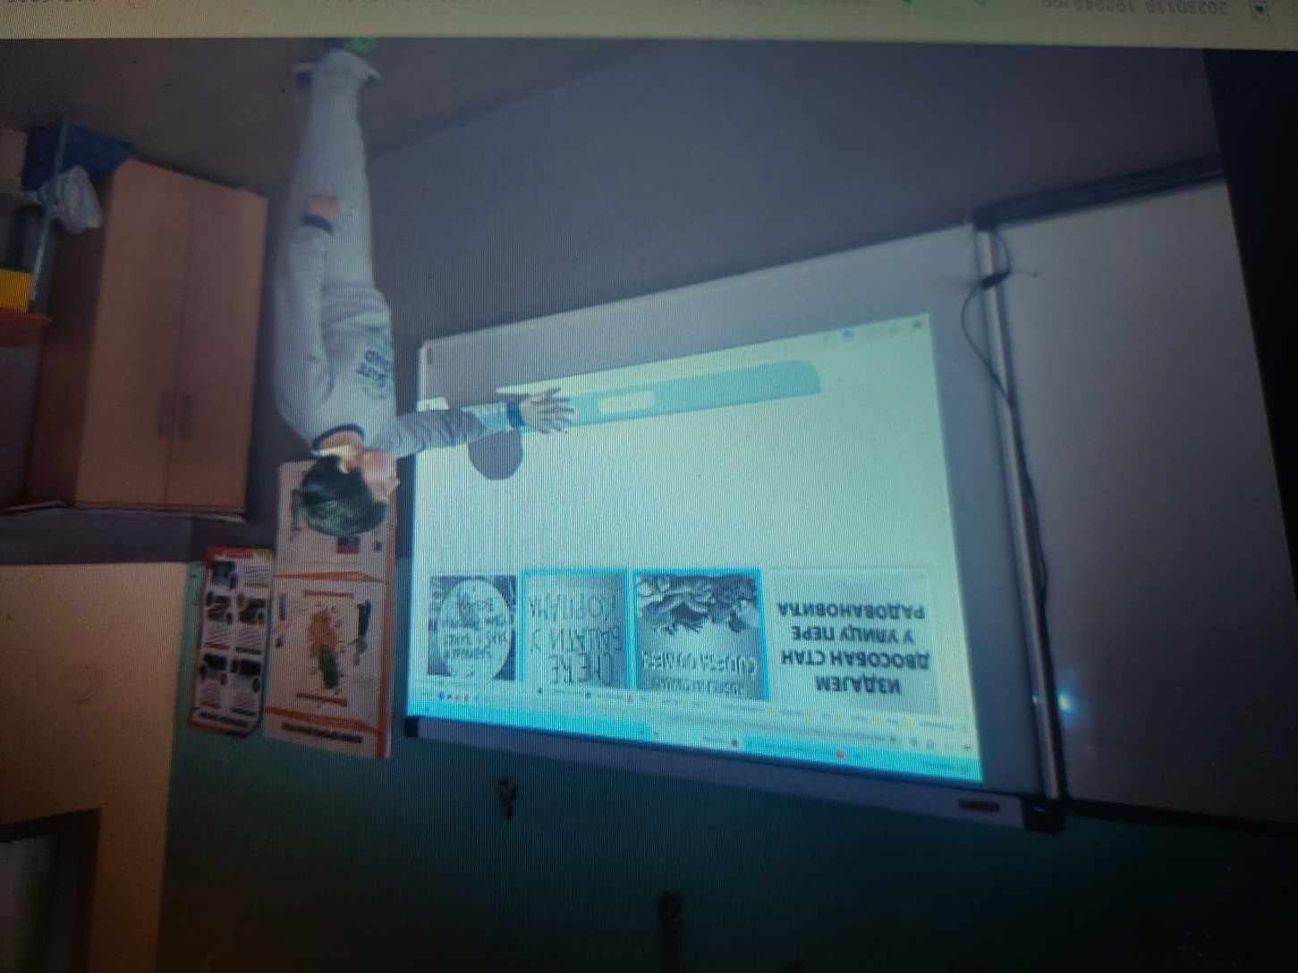
Grammar practice online activity 4

Slide 27
The list of ICT tools – Booklet
https://twinspace.etwinning.net/files/collabspace/6/86/086/178086/files/c3b0199b2.pdf
There is a suggested list of ICT tools for students to use at home for their schoolwork and at school in classes. The tools are safe and useful for developing digital skills and competencies.

Slide 28
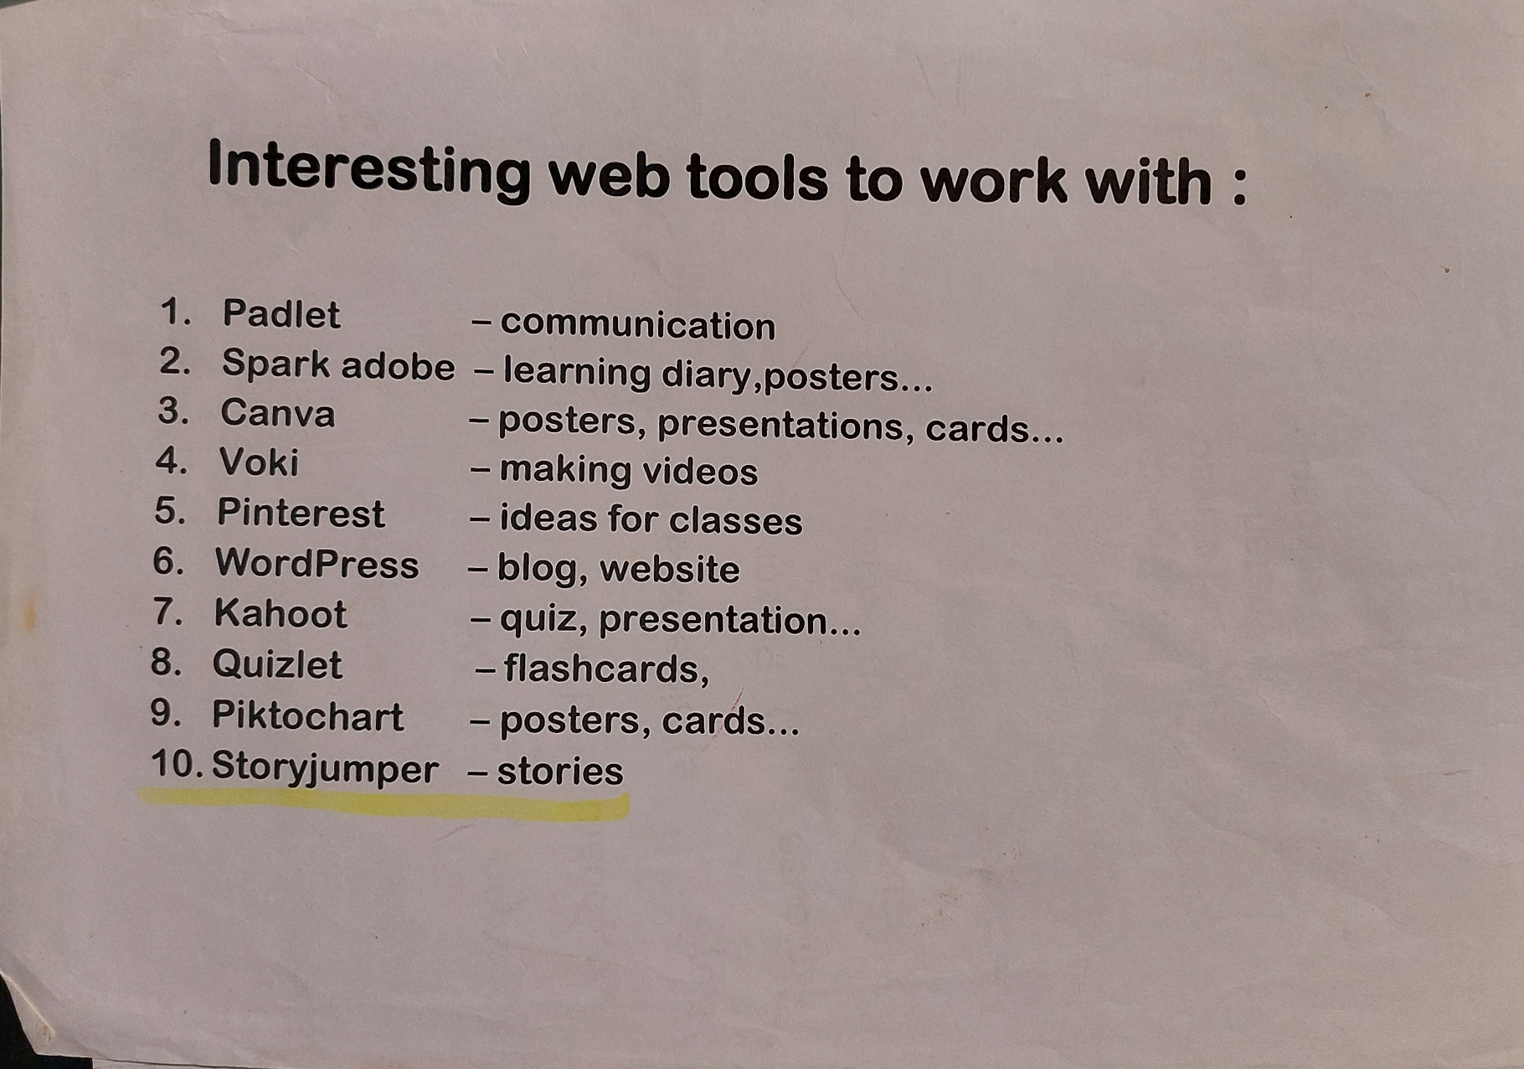
List of our favourite iTools

Slide 29
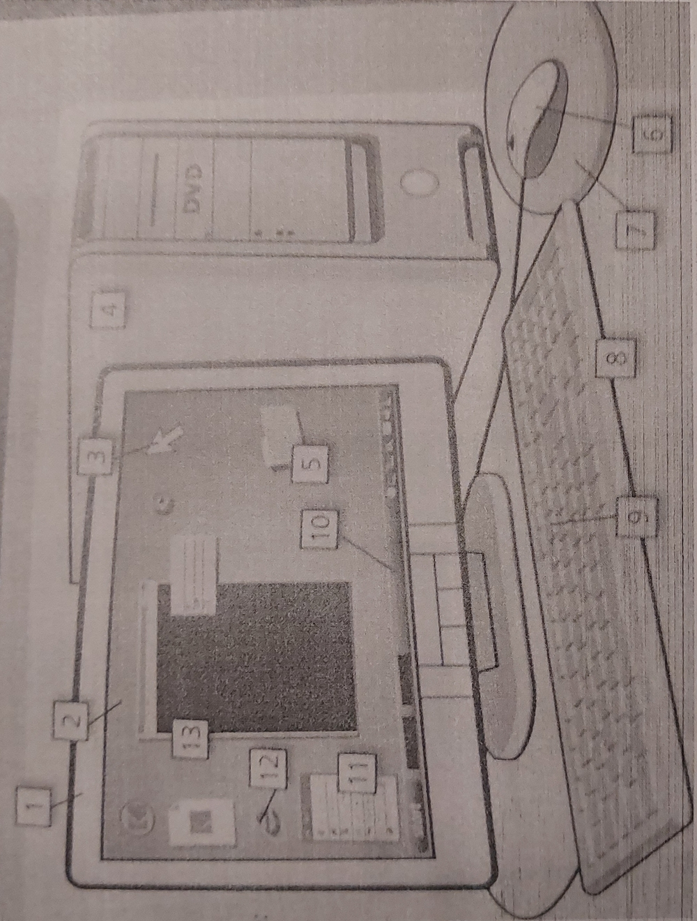
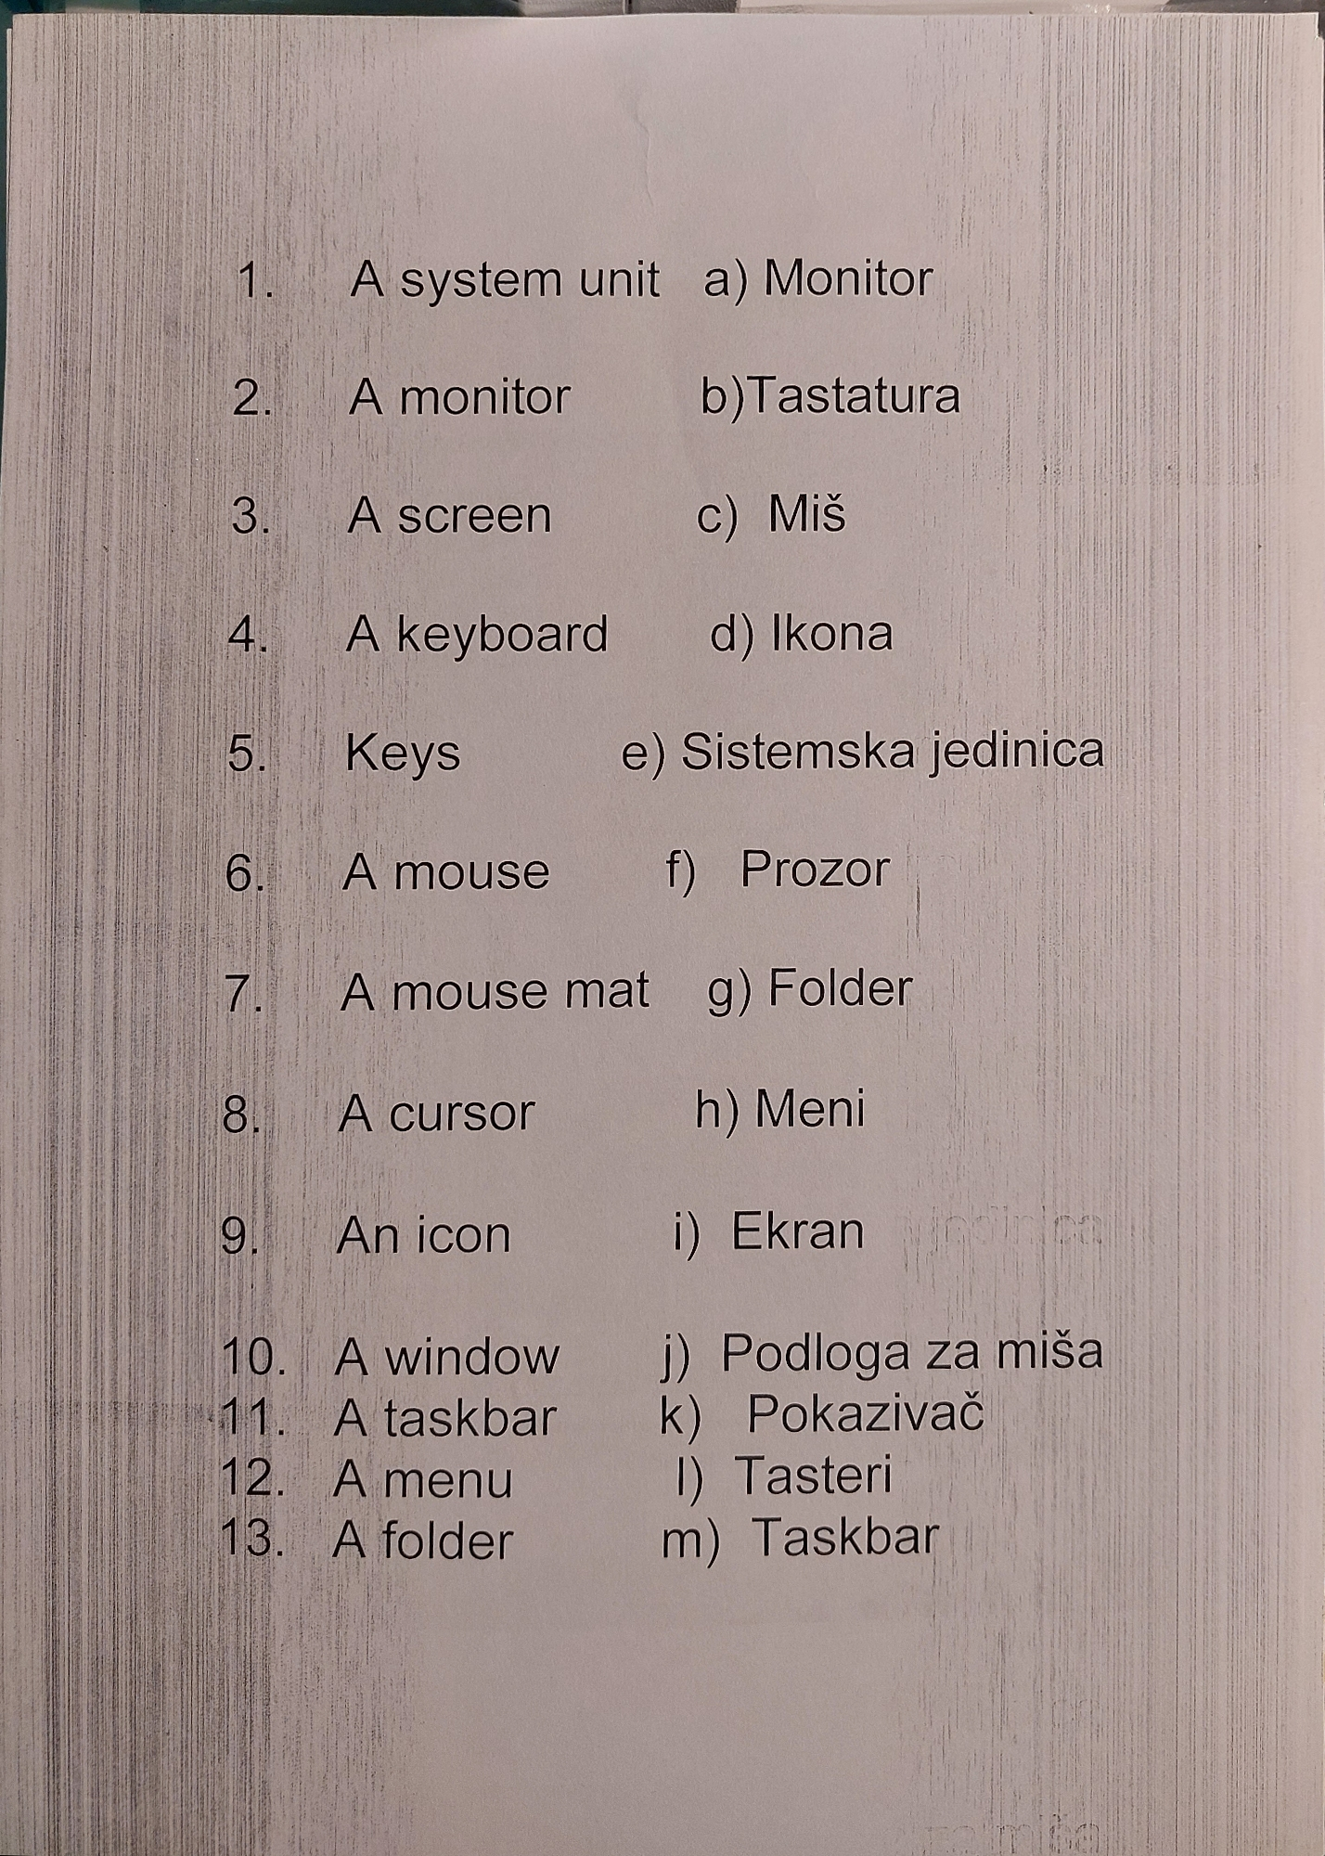
Materials ( pre-work activity)

Slide 30
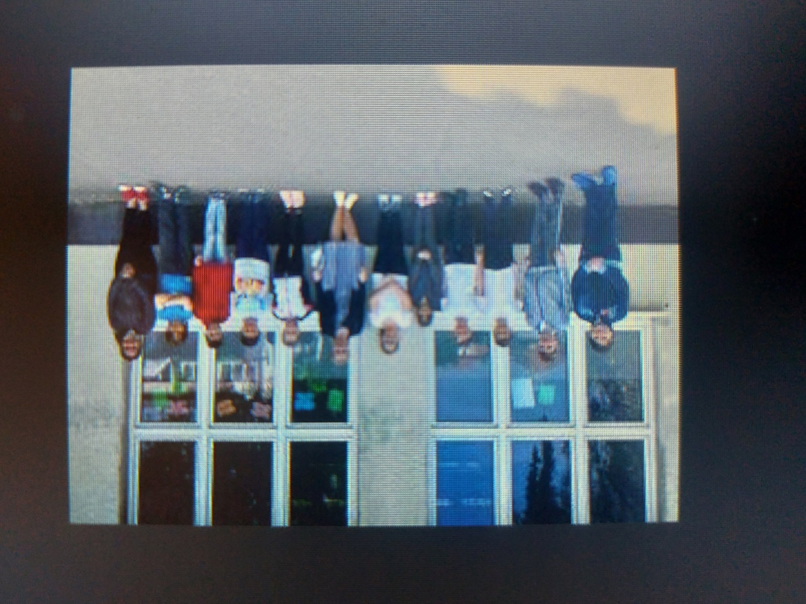
Slovak team

Slide 31
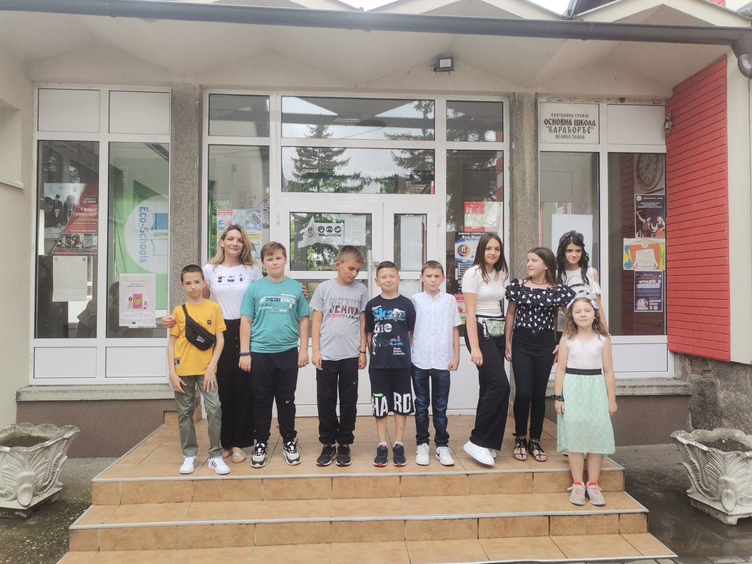
Serbian team

Slide 32
Impressions
Students loved the project because most of them have been using some of the itools for the first time and it was something out of their comfort zone which made them more secure and confident in using their skills and possibilites in the classroom. They met new friends, collaborate, communicated and progressed in all these planned areas and more.

